Slide 1

Integrating the Safety-A Suicide Assessment Program into Clinical Practice
Enhancing Risk Formulation and Intervention
Colleen Neal, PMHNP-BC
Texas Society for Psychiatric Physicians

Slide 2
🎯 Learning Objectives
Explain the theoretical foundation & clinical rationale
01
Integrate Safety-A into evaluations
02
Utilize a framework for safety planning & care decisions
03

Slide 3
Introduction: Integrating Safety-A into Clinical Practice
Importance of suicide prevention:
Primary care
Outpatient psychiatry settings
Community
Special populations: adolescents, veterans, medically complex patients
Clinical challenges in assessing and managing suicide risk
Role of structured protocols like Safety-A

Slide 4
📚 Theoretical Foundation
Background: FISP
Evidence-based intervention for improving continuity of care and increasing linkage to treatment after an initial emergency/acute care visit
Listed in the National Registry of Evidence-Based Practices (NREPP)
Associated with protection from suicide attempts during the high-risk 3-month period after suicide/self-harm episodes
Through a trauma lens

Slide 5
🔍 Overview of Safety-A Program
What is Safety-A?
TCMHCC
Training
https://tcmhcc.utsystem.edu/safety-a/
Handouts

Slide 6
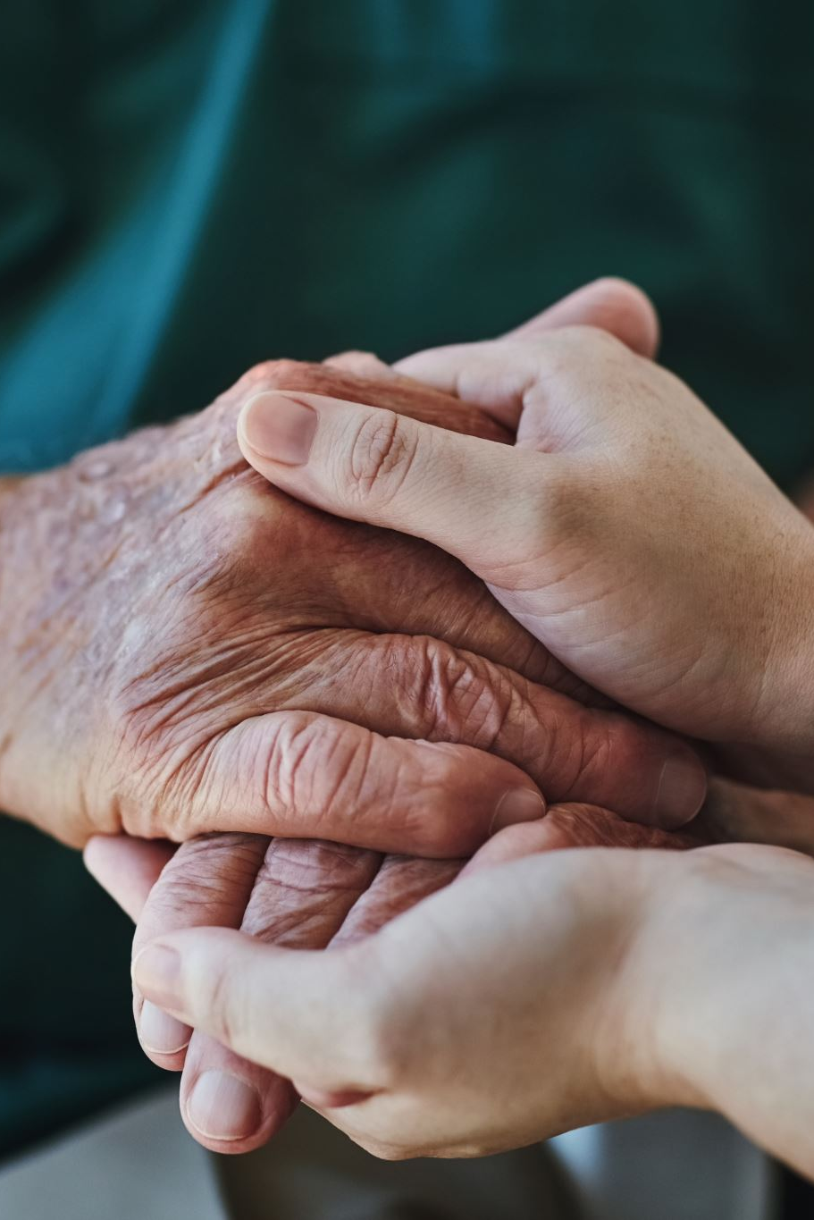
SAFETY-A GOALS
Assessment of Imminent Risk
Other risk/protective factors
Therapeutic Components
Improve linkage to outpatient treatment
Increase safety
Increase protective processes: family support; protection- restrict access to lethal means, protective monitoring
Increase hope, improve youth emotion regulation, distress tolerance, and ability to get through unbearable pain/problems

Slide 7
INDIVIDUAL YOUTH SESSION COMPONENTS
Agenda setting: reason for meeting
Youth strengths
Family strengths
Feelings thermometer
Personal safety plan
Substance use/means safety (guns)
Follow-up

Slide 8

STRENGTHS
Strengthen Hope, Reasons for Living, Pull for Strengths
≥ 3 strengths youth recognizes in him/herself
≥ 3 strengths youth recognizes in family member/other
Change the Session Rhythm
Start with Strengths
“Drag out” behaviors
Incompatible with
Suicide/self-harm

Slide 9
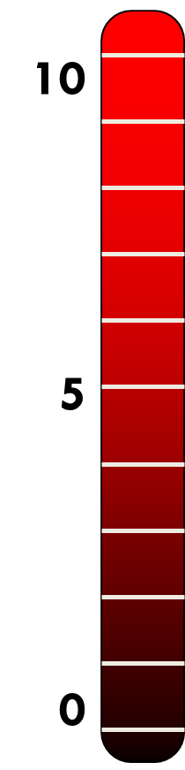
Feeling Thermometer
Begin with 0 (calm, comfortable)
Shift to 10 (most stressed; identify triggers of suicidal/SH urges)
Identify a 5 (neutral)
Identify progression from a neutral feeling to a dangerous feeling
When do you start to notice that things are starting to head up from a 5 and up toward a 10?
Attend to situations, thoughts, feelings, body sensations, and behaviors that appear to be key triggers.
These prompting events & warning signs will be signals to the teen that they will need to use their Personal Plan

Slide 10
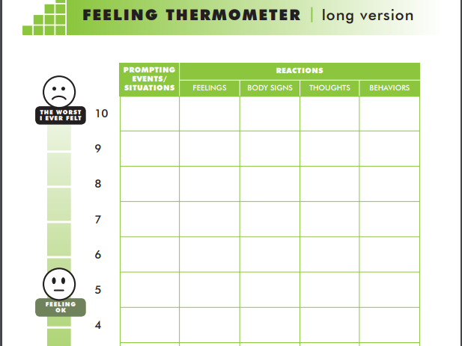

Slide 11
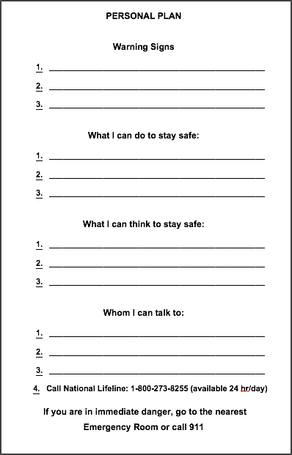

Slide 12
INDIVIDUAL PARENT SESSION COMPONENTS
Agenda setting: reason for meeting
Youth AND family strengths
Personal safety plan
Substance use/means safety (guns)
Follow-up
Notes:
When we address the parents, we want to be sensitive to their feelings:
Remembering parents have feelings, too.
We want to use a trauma informed lens; Does not only include youth: can also be the parent
possibly saw their child almost die;
Build rapport
We are a team; supporting child
Helping the parents get on board
We are all on the same team of supporting the child
Changes the tenor of the session: parents are frustrated: acknowledge the frustration but remind them there are strengths of their family

Slide 13
📝 Safety-A Protocol Components
At risk youth: youth session

Slide 14
👤 Case Example
Patient presenting with suicidal ideation
Walk through Safety-A assessment & planning
Demonstrate structured decision-making

Slide 15
🤝 Safety Planning with Safety-A
Patient collaboration & engagement
Crisis management strategies
Means restriction counseling
Follow-up & continuity of care

Slide 16
🗂️ Documentation & Communication
Standardized documentation language
Liability protection through evidence-informed approach
Communicating with multidisciplinary teams

Slide 17
⚖️ Benefits & Challenges
Benefits: Structure, defensibility, patient engagement
Challenges: Time, training, clinician adoption
Solutions: Training, EMR integration, workflow support

Slide 18
✨ Clinical Pearls
Engage patients with empathy & transparency
Prioritize collaborative safety planning
Use Safety-A to support — not replace — clinical judgment

Slide 19
✅ Summary & Takeaways
Safety-A = structured, evidence-based, clinically practical
Supports competence in suicide risk assessment & safety planning
Enhances quality of care and patient safety

Slide 20
❓ Q&A
Questions?
Contact: Colleen Neal, PMHNP-BC

Slide 21
References
Texas Child Mental Health Care Consortium (2025). Safety-A. Retrieved from https://tcmhcc.utsystem.edu/safety-a/

Slide 22
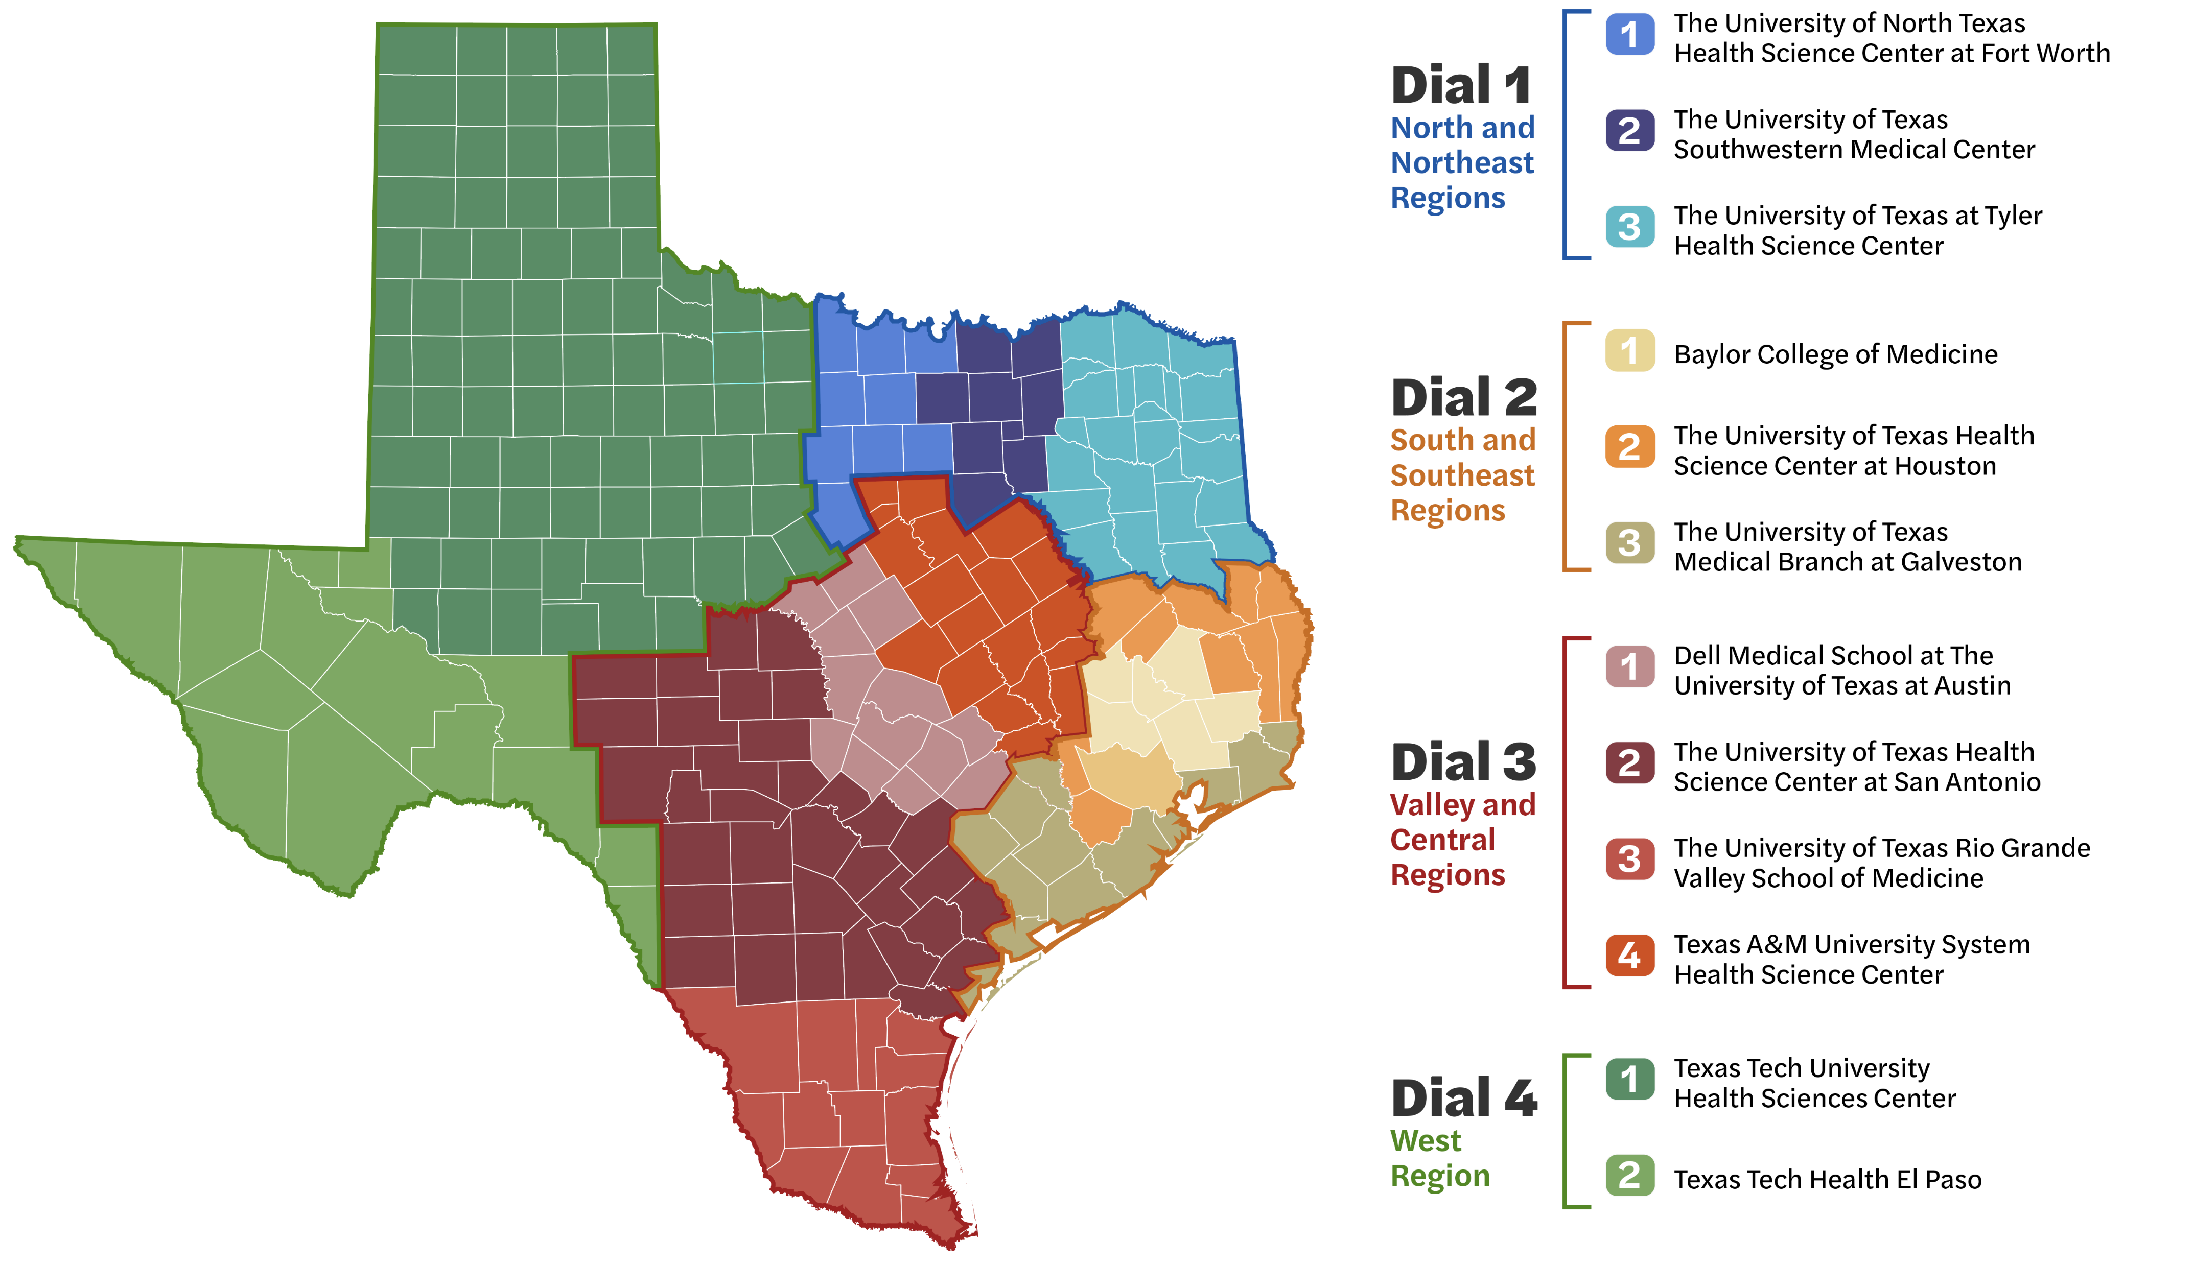

Coverage Map
Notes:
CPAN is available statewide and anchored in 12 medical school hubs to cover the entire state. We are a team working together throughout the entire state – for a quick, expert response, we can roll calls to another hub or connect with our CPAN and PeriPAN colleagues for additional input.

Slide 23

No call is too small. You can call us with a quick question or about your most complex patients.
Questions about:
Diagnosis
Treatment
Medication management
Level of care
Challenging cases
Specialists & referrals
Clinic protocols
Notes:
Here is an overview and reminder of some of the reasons clinicians call or text us. No call is too small.

Slide 24
How Does CPAN Work?
Call 888-901-CPAN (2726)
It’s simple to sign up, easy to use, fast and free.
Anyone in your office can call or text us.
5
minutes
to sign up for CPAN.
Texting number provided by each local CPAN team.
5
minutes
30
minutes
or less to reach a mental health clinician
or less to consult with a psychiatrist, or at a scheduled callback time
1
business day
for vetted referrals
No call is too small. Call as often as needed.
Teams are available Monday-Friday, 8 a.m. to 5 p.m. After-hours messages returned next business day.
Notes:
At CPAN, we pride ourselves in a rapid response to keep pace with your busy schedule and save you time by doing some of the legwork for you.

Slide 25
How Does CPAN Work?
PCP or Pediatrician
Seeks Advice
Call 888-901-CPAN
Or Text Your Local Hub
A knowledgeable behavioral health specialist is standing by to assist.
Possible Outcomes:
Psychiatrist consult
Guidance to PCP to assess or treat patient
Local, vetted referrals or resources
Direct patient consult may be recommended
To ensure a rapid, expert response, CPAN can draw upon its 12 program hubs
Notes:
Here is an overview of the CPAN process when a clinician – or someone from a clinician’s office – contacts us.
We are set up for a rapid response, drawing upon the CPAN hub in your region as well as the other 11 hubs across the state as needed to ensure you receive the expert support you need.
When you or a someone in your clinic calls or texts us, you reach a behavioral health clinician right away who can respond to your request, including by connecting you to a psychiatrist within 30 minutes or at a callback time that works for you.
Here are the main possible outcomes of your call.

