Slide 1

Recognizing Eating Disorders and Utilizing Effective
Treatment Modalities
Susan C. Mengden, PhD, CEDS-C, CGP
TSPP Convention| November 8, 2025

Slide 2

Susan C Mengden, PhD, CEDS-iaedp Approved Consultant
Executive Director
Susan C. Mengden, PhD, Certified Eating Disorder Specialist-iaedp Approved Consultant, and Certified Group Psychotherapist is the Founder and Executive Director of Esperanza Eating Disorders Center in San Antonio, Texas. Mengden, a native Texan earned her BA, MBA at UT Austin and MA, PhD in Psychology from Boston College.
Mengden has 36 years of clinical experience specializing in eating disorder treatment. Her eating disorder clinical experience includes Inpatient Hospitalization, US Military IOP and community facility-based PHP, IOP and Outpatient levels of care. Mengden has founded two stand-alone PHP/IOP eating disorder programs. Currently, she serves on the IAEDP Foundation Board of Directors as Treasurer and on the Leadership Team of the San Antonio IAEDP Chapter.
She is intensively trained in Dialectical Behavioral Therapy (DBT), Cognitive Behavioral Therapy (CBT), Family-Based Treatment (FBT), and Mindfulness-Based Stress Reduction (MSBR) and regularly offers trainings and educational presentations.

Slide 3
Objectives
Learn the DSM-5 diagnostic criteria for the eating disorders.
Learn the causes and underlying factors in development, the clinical signs and symptoms, and physical consequences of an eating disorder.
Learn the treatment philosophies, treatment levels and the evidence-based treatment approaches for the eating disorders.

Slide 4
Agenda
Rationale for the need of eating disorder education
DSM-5 Diagnostic Criteria for Eating Disorders
Signs and Symptoms and Early Recognition
Evidence-Based Treatment
Levels of Care for Treatment

Slide 5
“It’s not about the food; it’s what we do with the food and movement.”
“It’s not about the food; it’s what one does with food and movement.”

Slide 6
Assess for Eating Disorders
Gender Dysphoria
LBGTQ+ Population
Food Insecure Population
Self-Harm Population
Athletes
  judged sports
  runners

Slide 7
Early Recognition
Consider evaluating an individual for an ED who presents with any of the following:
Weight loss or failure to gain expected weight/height in a child or adolescent who is still growing and developing
Precipitous weight changes (significant weight lost or gained)
Sudden changes in eating behaviors (new vegetarianism/veganism, gluten-free, lactose-free, elimination of certain foods or food groups, eating only “healthy” foods, uncontrolled binge eating)
Sudden changes in exercise patterns, excessive or compulsive exercise or involvement in extreme physical training
Body image disturbance, the desire to lose weight despite low or
normative weight, or extreme physical training
Source: AED Report 2016/3rd Edition
Eating Disorders: A Guide to Medical Care

Slide 8
Early Recognition
Consider evaluating an individual for an ED who presents with any of the following:
Unexplained infertility
Excessive exercise or involvement in extreme physical training
Rigid and excessive preoccupation with weight, dieting, appearance, exercise
Constipation in the setting of other inappropriate dieting and/or weight loss promoting behaviors
Type 1 diabetes mellitus and unexplained weight loss and/or poor metabolic control or diabetic ketoacidosis (DKA). Intentionally changing insulin doses (under-dosing or omission) will lead to weight loss, poor glycemic control, (high hemoglobin A1c) hypo/hyperglycemia, DKA, and
acceleration of diabetic complications

Slide 9
Early Recognition
Abdominal complaints in the context of weight loss behaviors
Electrolyte abnormalities without an identified medical cause (especially hypokalemia, hypochloremia, or elevated bicarbonate)
Substantial weight fluctuations
Type 1 diabetes mellitus with poor glucose control or recurrent diabetic ketoacidosis (DKA) with or without weight loss
Use of compensatory behaviors (i.e., self-induces vomiting, laxative abuse, dieting, fasting or excessive exercise) to influence weight after eating or binge eating
Source: AED Report 2016/3rd Edition
Eating Disorders: A Guide to Medical Care

Slide 10
Early Recognition
Inappropriate use of appetite suppressants, caffeine, diuretics, laxative, enemas, ipecac, artificial sweeteners, sugar-free gum, prescription medications that affect weight (insulin, thyroid medications, psychostimulants, or street drugs) or nutritional supplements marketed for weight loss
Bradycardia
Amenorrhea or menstrual irregularities
Fainting/Dizziness
Source: AED Report 2016/3rd Edition
Eating Disorders: A Guide to Medical Care

Slide 11
Early Recognition
Consider evaluating an individual for an ED who presents with any of the following:
Precipitous weight loss/gain
Weight loss or failure to gain expected weight/height in a child or adolescent who is still growing and developing
Substantial weight fluctuations
Electrolyte abnormalities (with or without ECG changes), especially in hypokalemia, hypochloremia, or elevated CO₂. High-normal CO₂ in the presence of low normal chloride and/or urine pH of 8.0 - 8.5 can indicate recurrent vomiting. Hypoglycemia may accompany such electrolyte changes
Bradycardia
Amenorrhea or menstrual irregularities

Slide 12
Causes/Underlying Factors in the Development of an Eating Disorder
Individual Factors:
  Genetic Studies
  Low self-esteem , Feelings of Lack of Control
  Personality Traits
  Athletics
  Gender Identity/Dysphoria
  Mood, Anxiety, Trauma, Self-Harm, Personality Disorder
Family/Parental Factors:
  Overprotective, Chaotic, Attachment, Poor Emotional Communication, Invalidation, Poor Support, Divorce, Multiple Relocations
Societal Factors: (ALL exacerbated by COVID-19)
  The Culture of Thinness
  Diet Mentality

Slide 13
Causes/Underlying Factors in the Development of an Eating Disorder
Social Factors:
  Social Media – weight loss ads, pro-anorexia websites
  Public Policy on obesity
  Cultural issues in San Antonio
  Food Insecurity
  Models and Television
  Athletes and Coaches
  Body Bullying – history of being teased based on size or weight
  History of physical or sexual abuse
  Body Talk
  Healthcare providers
  Military H/W Standards
  Health Classes and Instruction
  Fitness Gram Pacer Test Procedures
  Easy access to diet pills, laxatives

Slide 15
Presenting Signs and Symptoms
General
Marked weight loss, gain or fluctuations
Weight loss, weight maintenance or failure to gain expected weight in a child or adolescent who is still growing and developing
Cold intolerance
Weakness
Fatigue or lethargy
Dizziness
Syncope - fainting due to low BP
Hot flashes, sweating episodes
Dehydration
Oral & Dental
Oral trauma/lacerations
Dental erosion and dental caries
Parotid enlargement
Gastrointestinal
Epigastric discomfort
Early satiety, delayed gastric emptying
Gastroesophageal reflux
Hematemesis (vomiting of blood)
Hemorrhoids and rectal prolapse
Constipation

Slide 16
Presenting Signs and Symptoms
Dermatologic
Lanugo hair
Hair loss
Yellowish discoloration of skin
Russell’s sign (calluses or scars on the back of the hand from self-induced vomiting)
Poor wound healing
Dry brittle hair and nails
Endocrine
Amenorrhea or irregular menses
Loss of libido
Stress fractures
Low bone mineral density
Low estrogen
Low testosterone
Neuropsychiatric
Seizures
Memory loss
Poor concentration
Insomnia
Depressive/Anxious/Obsessive behavior/
Compulsive symptoms and behaviors
Self-harm
Suicidal thoughts, plans or attempts

Slide 17
Eating Disorders Overview
DSM-5:
- AN, BN, BED, ARFID, OSFED
Prevalence Rates
  Anorexia: 1% Female and .3% Males
  Bulimia: 1.5 % Females and .5% Males
  Binge Eating Disorder: 3.5% Females and 2% Males
  ARFID: Preliminary Studies
    5% Children - boys at higher risk than girls
Prevalence Rates Updates – DOUBLED DURING 2020

Slide 18
Types of Eating Disorders
Anorexia Nervosa
  Restricting Type
  Binge-Eating/Purging Type
Bulimia Nervosa
Binge-Eating Disorder
ARFID - Avoidant/Restrictive Food Intake Disorder
OSFED - Other Specified Feeding or Eating Disorder

Slide 19
DSM-5 Criteria for Anorexia Nervosa
Restriction of energy intake relative to requirements, leading to a significantly low body weight in the context of age, sex, developmental trajectory and physical health. Significantly low weight is defined as a weight that is less than minimally normal or, for children and adolescents, less than that minimally expected.
Intense fear of gaining weight or of becoming fat, or persistent behavior that interferes with weight gain, even though at a significantly low weight.
Disturbance in the way in which one’s body or shape is experienced, undue influence of body weight or shape on self-evaluation, or persistent lack of recognition of the seriousness of the current low body weight.

Slide 20
DSM-5 Criteria for Anorexia Nervosa
Subtypes
  Restricting Type: weight loss is accomplished primarily through dieting, fasting and/or excessive exercise
  Binge-Eating/Purging Type: recurrent episodes of binge-eating or purging behaviors, i.e..vomiting, misuse of laxative, diuretics or enemas
Levels of Severity
  Mild: BMI > 17
  Moderate: 16-16.99
  Severe: BMI: 15-15.99
  Extreme: BMI < 15

Slide 21
Signs of Anorexia Nervosa
Preoccupation with weight, food, calories, fat grams and dieting.
Refusal to eat certain foods, progressing to restrictions against whole categories of food (e.g., no carbohydrates, etc.).
Frequent comments about feeling “fat” or overweight despite weight loss.
Anxiety about gaining weight or being ”fat.”
Denial of hunger.
Development of food rituals (e.g., eating foods in certain orders, excessive chewing, rearranging food on a plate).
Consistent excuses to avoid mealtimes or situations involving food.
Excessive, rigid exercise regimen - despite weather, fatigue, illness or injury - the need to “burn off” calories taken in.
Withdrawal from usual friends and activities.
In constant motion (stands instead of sits), wiggles legs.

Slide 22
Consequences of Anorexia Nervosa
High mortality rate - up to 20%
Other complications include anemia, reduced bone mass, infertility and brain abnormalities
Severe dehydration, which can result in kidney failure
Fainting, fatigue and overall weakness
Dry hair and skin, hair loss is common
Infertility, loss of menses

Slide 23
DSM-5 Criteria for Bulimia Nervosa
Recurrent episodes of binge eating. An episode of binge eating is characterized by both of the following:
  Eating, in a discrete period of time (e.g., within any 2-hour period), an amount of food that is definitely larger than what most individuals would eat in a similar period of time under similar circumstances.
  A sense of a lack of control overeating during the episode (e.g., a feeling that one cannot stop eating or control what or how much one is eating).
Recurrent inappropriate compensatory behaviors in order to prevent weight gain, such as self-induced vomiting; misuse of laxative, diuretics, or other medications; fasting; or excessive exercise.
The binge eating and inappropriate compensatory behaviors both occur, on average, at least once a week for 3 months.
Self-evaluation is unduly influenced by body shape and weight.
The disturbance does not occur exclusively during episodes of anorexia nervosa.
Levels of Severity
  Mild: 1-3 compensatory behavior episodes per week
  Moderate: 4-7 compensatory behavior episodes per week
  Severe: 8-13 compensatory behavior episodes per week
  Extreme: 14+ compensatory behavior episodes per week

Slide 24
Signs of Bulimia Nervosa
Evidence of binge-eating, including disappearance of large amount of food in sort periods of time or the existence of wrappers and containers indicating the consumption of large amounts of food
Evidence of purging behaviors, including frequent trips to the bathroom after meals, signs and/or smells of vomiting, presence of wrappers or packages of laxatives or diuretics
Excessive rigid exercise regimen - despite the weather, fatigue, illness or injury - the need to “burn off” calories taken in
Unusual swelling of the cheeks or jaw area
Calluses on the back of the hands and knuckles from self-induced vomiting
Discoloration or staining of the teeth
Creation of complex lifestyle schedules or rituals to make time for binge-and-purge sessions
Excessive use of gum/breath fresheners
Nose bleeds
Sore throat without strep diagnosis

Slide 25
Consequences of Bulimia Nervosa
Electrolyte imbalances that can lead to irregular heartbeats and possibly heart failure and death
Inflammation and possible rupture of the esophagus from frequent vomiting
Tooth decay and staining from stomach acids released during frequent vomiting
Chronic irregular bowel movements and constipation as a result of laxative abuse
Heart Arrythmias and cardiomyopathy, or deterioration of the heart
Dehydration/Orthostasis
Low blood glucose

Slide 26
DSM-5 Criteria for Binge-Eating Disorder
Recurrent episodes of binge-eating. An episode of binge-eating is characterized by both of the following:
  Eating, in a discrete period of time (e.g., within any 2-hour period), an amount of food that is definitely larger than what most people would eat in a similar period of time under similar circumstances.
  A sense of lack of control overeating during the episode (e.g., a feeling that one cannot stop eating or control what or how much one is eating).
The binge-eating episodes are associated with 3 (or more) of the following:
  Eating much more rapidly than normal.
  Eating until feeling uncomfortably full.
  Eating large amounts of food when not physically hungry.
  Eating alone because of feeling embarrassed by how much one is eating.
  Feeling disgusted with oneself, depressed, or guilty afterward.

Slide 27
DSM-5 Criteria for Binge-Eating Disorder
Marked distress regarding binge-eating is present.
The binge-eating occurs, on average, at least once a week for 3 months.
The binge-eating is not associated with the recurrent use of inappropriate compensatory behavior as in bulimia nervosa and does not occur exclusively during the course of bulimia nervosa or anorexia nervosa.
Levels of Severity
  Mild: 1-3 episodes per week
  Moderate: 4-7 episodes per week
  Severe: 8-13 episodes per week
  Extreme: 14+ episodes per week

Slide 28
Signs of Binge-Eating Disorder
Excessive amounts of food containers and wrappers (often hidden)
Continuous grazing without feeling satisfied
Experimenting with different diets; eating publicly in a very restrictive manner (many will only eat “healthy” foods in front of others)
A large amount of money going towards binge food; running through his/her college meal plan well before the semester ends (parents or friends may best be able to assess this)
Possible binge drinking that may or may not precipitate binge-eating
Symptoms of anxiety and depression: depressed or anxious mood, loss of interest or withdrawing from peers, hypersomnia or insomnia, increased irritability or agitation, etc.
Missing activities, work, class, etc., to binge
Discussing Body Image in a negative manner; expressing shame regarding body image
Weight gain (however, keep in mind many binge eaters are of average weight)

Slide 29
Consequences of Binge-Eating Disorder
Weight Gain
Type II Diabetes
High cholesterol
High blood pressure
High triglycerides
Fatty liver
Infertility - PCOS
Sleep Apnea
Constipation/Hemorrhoids

Slide 30
DSM-5 Criteria for ARFID
An eating or feeding disturbance (e.g., apparent lack of interest in eating or food; avoidance based on the sensory characteristics of food; concern about aversive consequences of eating) as manifested by persistent failure to meet appropriate nutritional and/or energy needs associated with one (or more) of the following:
  Significant weight loss (or failure to achieve expected weight gain or faltering growth in children).
  Significant nutritional deficiency.
  Dependence on enteral feeding or oral nutritional supplements.
  Marked interference with psychosocial functioning.
The disturbance is not better explained by lack of available food or by an associated culturally sanctioned practice.
The eating disturbance does not occur exclusively during the course of anorexia nervosa or bulimia nervosa, and there is not evidence of a disturbance in the way in which one’s body weight or shape is experienced.
The eating disturbance is not attributable to a concurrent medical condition or what is not better explained by another mental disorder. When the eating disturbance exceeds that routinely associated with the condition or disorder and warrants additional clinical attention.

Slide 31
Presentations and Signs of ARFID
Avoidant/Sensory Sensitive: Individuals who only accept a limited diet in relation to sensory features
  Sensory aversions
  Sensory over-stimulation
  Long-standing in nature
  Often rigid about food preparation, food brands, food rituals
  May or may not be underweight
Aversion: Individuals whose food refusal is related to aversion or fear-based experiences (phobic avoidance)
  Choking
  Nausea
  Vomiting (emetophobia)
  Pain
  Swallowing
  Often on growth/weight curves for age before aversive incident

Slide 32
Presentations and Signs of ARFID
Restrictive/Limited Interest: Individuals who do not eat enough and show little interest in feeding or eating (low appetite)
  Extreme pickiness
  Distractible and forgetful
  Low appetite, early satiety
  Tend to “graze”
  Indifference to food
  Long standing
Mixed Type (avoidant and restrictive)
  Avoidant and restrictive features that co-exist at presentation but were not at onset of symptoms
  Usually baseline restrictive with acquired aversion features

Slide 33
Presentations and Signs of ARFID
ARFID “PLUS”: Individuals with avoidant, aversive, or restrictive types of ARFID presentations who begin to develop features of AN
  Concerns about body weight and size
  Fear of weight gain
  Negativity about fatness
  Negative body image without body image distortion
  Preference for less calorically dense foods

Slide 34
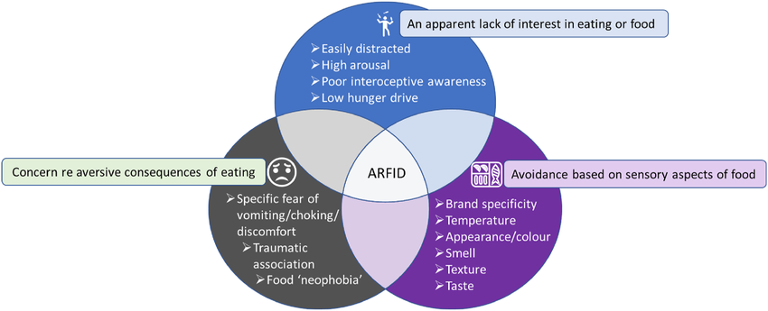
Drivers/Subtypes of ARFID
Archibald & Waugh, 2022
@esperanzaedc

Slide 35
Misperceptions about ARFID
Not “just picky eating”
  Feeding and eating difficulties are present in about 25% of children
  ARFID differs from childhood selective eating which usually improves in middle childhood without treatment
  ARFID doesn’t get better on its own
Can occur along the weight continuum
  Clients with ARFID present in a variety of shapes and sizes
  Important to remember that clients who are higher weight can be medically unstable or malnourished
Can occur at any age
  ARFID does not always start in childhood, but many clients have onset at birth
  ARFID can have a sudden onset or a gradual onset

Slide 36
Epidemiology of ARFID
Approximately 15% of new eating disorder cases presenting for treatment
Current research suggests more comparable male to female presentations
Mean age of diagnosis is age 11 years old, however symptoms often present earlier
20% of ARFID clients display a preoccupation with somatic concerns like GI distress
Disgust may play an important role in the development and perpetuation of ARFID

Slide 37
ARFID Comorbidity
Neurodevelopmental diagnoses and mental health conditions are common in ARFID:
  •Mood and anxiety disorders
  •ADHD
  •OCD
  •Autism Spectrum Disorder
  •Internet Gaming Disorder

Slide 38
OSFED - Other Specified Feeding or Eating Disorder
Atypical Anorexia
Bulimia of low frequency
Binge-eating disorder of low frequency
Purging Disorder - recurrent purging in the absence of binge-eating - vomiting, laxatives, diuretics and other medications
Night Eating Syndrome - eating after awakening from sleep, awareness and recall of eating behaviors

Slide 39
OSFED - Other Specified Feeding or Eating Disorder
Pica
Rumination Disorder

Slide 40
EATING DISORDERS COMPARISON CHART | ANOREXIA | BULIMIA | BINGE EATING DISORDER | ARFID
WEIGHT | Significantly underweight; BMI of less than 17.5 | Varies, usually normal weight or overweight | Usually overweight | Varies, can be normal weight, overweight or underweight
EATING HABITS | Takes in few calories, may eat only a limited variety of foods and may have odd food rituals | Binges by eating large amounts of food in a short period of time, then purges by vomiting and/or abusing laxative | Binges by eating large amounts of food in a short period of time, may restrict in between binges | Varied, restrictive of food groups, can binge on ”safe” foods
BODY IMAGE | Believes they are fat even when they are really under weight, obsessed with weight and appearance | Obsessed with weight and appearance | May be overly focused on weight and appearance | Not a disturbance
PHYSICAL SYMPTOMS | Extreme weight loss, low blood pressure, heart problems, kidney problems, hair loss, lanugo, weakness, fatigue, nutritional deficiencies, cessation of menstruation | Changes in weight, ulcers, sores in the mouth, sore throat, dehydration, dental problems, weakness, fatigue | Excessive weight gain, high blood pressure, diabetes, joint pain, fatigue | Varied, malnutrition and can have weight loss and failure to meet developmental weight and growth targets
EMOTIONAL SYMPTOMS | Depression, anxiety, obsessive-compulsive behaviors, denial that there is a problem, fear of gaining weight | Depression, anxiety, feelings of guilt, self-destructive behavior | Depression, feelings of guilt or self-hatred | Avoidant, anxiety, disgust
RELATIONSHIPS | Withdrawn, may refuse to eat in front of others | May be withdrawn but able to develop relationships with others | May be withdrawn, may seem overly sensitive | May be socially delayed due to eating behaviors

Slide 41
Duration of Illness
77% report duration of illness from 1 to 15 years*
1 – 5 years 30%
6 to 10 years 31%
11 to 15 years 16%
*National Association of Anorexia Nervosa and Associated Disorders ten-year study

Slide 42
Co-Morbid Disorders
Anxiety/Depression 66%
Obsessive-Compulsive Disorder 40%
Drugs/Alcohol 25-50%
PTSD/Trauma 30-60%

Slide 43
Is An Eating Disorder an Addiction ?
Both are behavioral disorders involving compulsive behaviors (eating, restricting, exercising, purging)
24.5% of AN have alcohol use disorder
33.7 % of BN have AUD
21.4% of BED have AUD
27.0% of AN have SUD with marijuana 2nd highest
36.8% of BN have any SUD
23.3% of BED have any SUD

Slide 44
Differences of Adolescent & Adult Eating Disorders
Motivation for Recovery
Family Involvement
Medical Complications

Slide 45
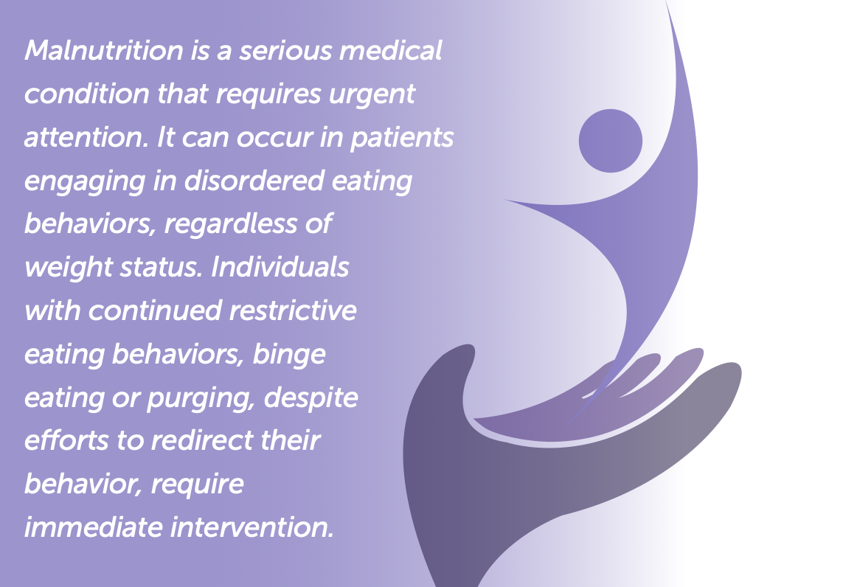
Source: AED Report 2016/3rd Edition
Eating Disorders: A Guide to Medical Care

Slide 46
Treatment for Eating Disorders
Guidelines for Treatment
Levels of Care
Treatment Approaches
Evidence Based Treatment
Assessments and Questionnaires for Eating Disorders

Slide 47
Eating Disorders and Treatment
APA Guidelines for Treatment (2012):
Multidisciplinary Treatment Team
1st goal: Weight Restoration/Cessation of B/P
Symptoms, Cessation of B/R symptoms, Cessation of compulsive and excessive exercise
Evidence-Based Treatment
  Behavioral Therapies

Slide 48

APA/NICE
Treatment Guidelines
Severity of behaviors determines the Level of Care
Multidisciplinary Treatment Team approach using Evidence-Based Treatment approaches
  Weight Restoration/Cessation of Purging symptoms and/or Compulsive and Excessive Exercise
  Identification and treatment of underlying psychological issues
  Family Therapy
  Re-establish social engagement

Slide 49
APA/NICE Guidelines
For Treatment Guidelines
Multidisciplinary treatment team to consist of:
  Psychiatrist
  Physician
  Mental Health Clinician
  Dietitian
Treatment Goals
  Weight restoration and/or cessation of purging behaviors
  Identification and treatment of underlying psychological issues
  Family Therapy
  Re-establish social engagement

Slide 50
APA Guidelines/Levels of Care
Medical
Suicidal ideation
Weight
Motivation
Comorbidities
Structure
Exercise
Purging
Environmental stress and supports

Slide 51
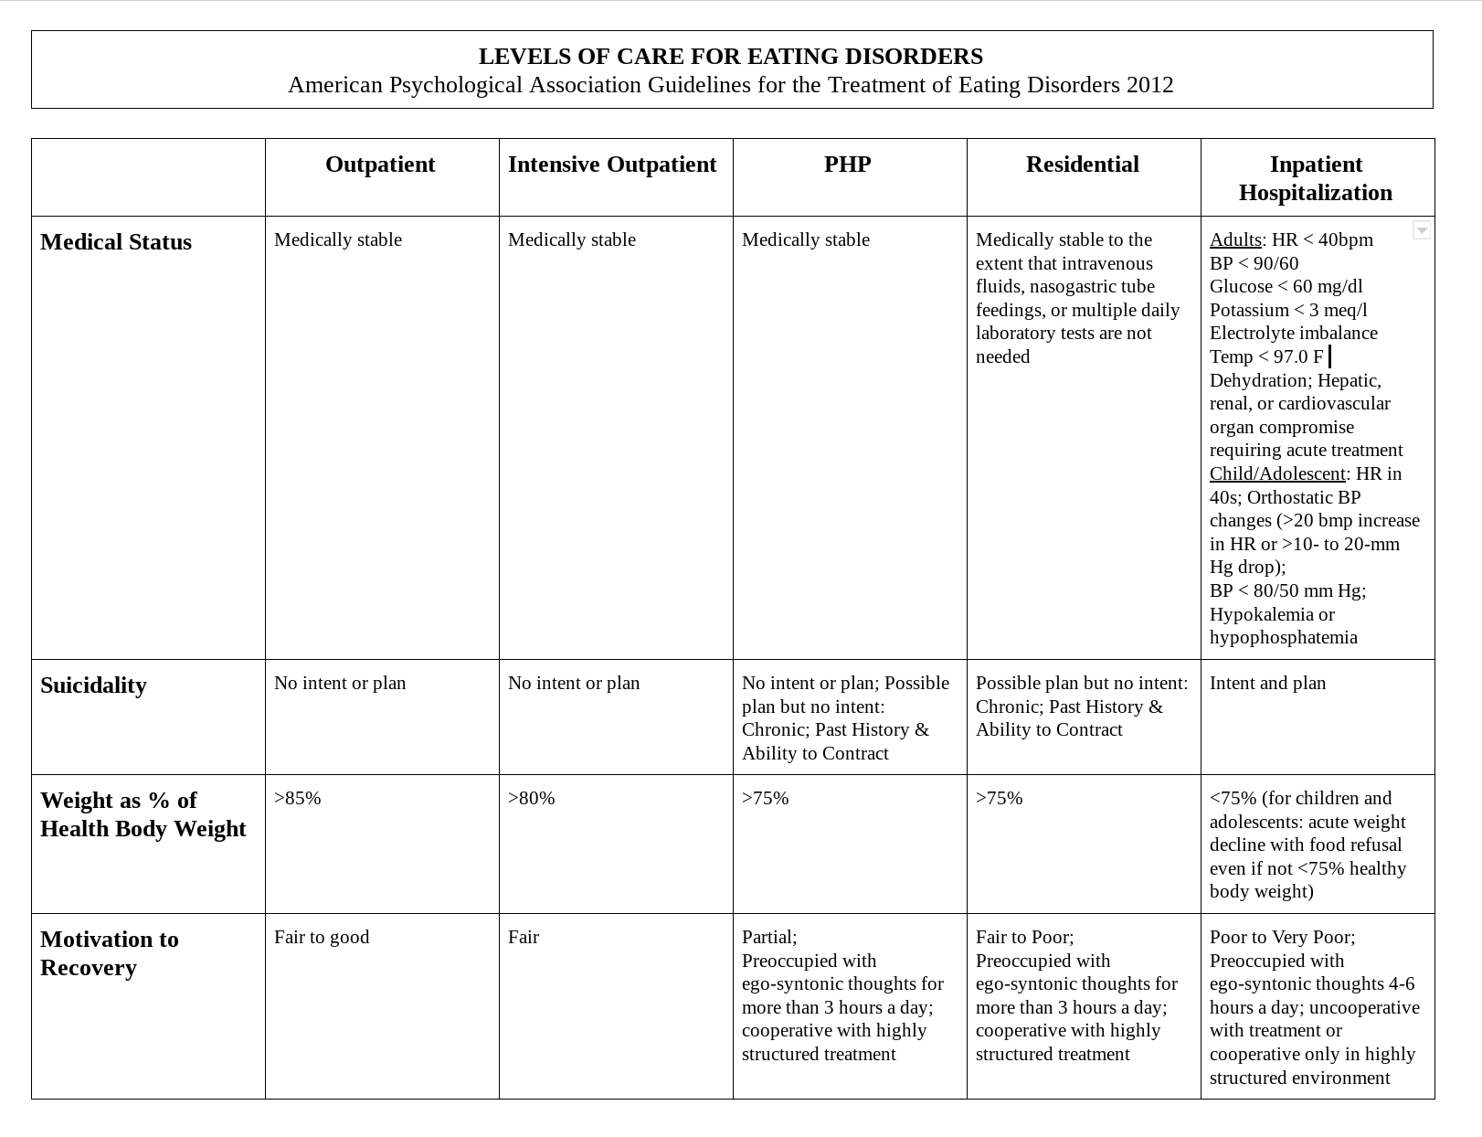

Slide 52
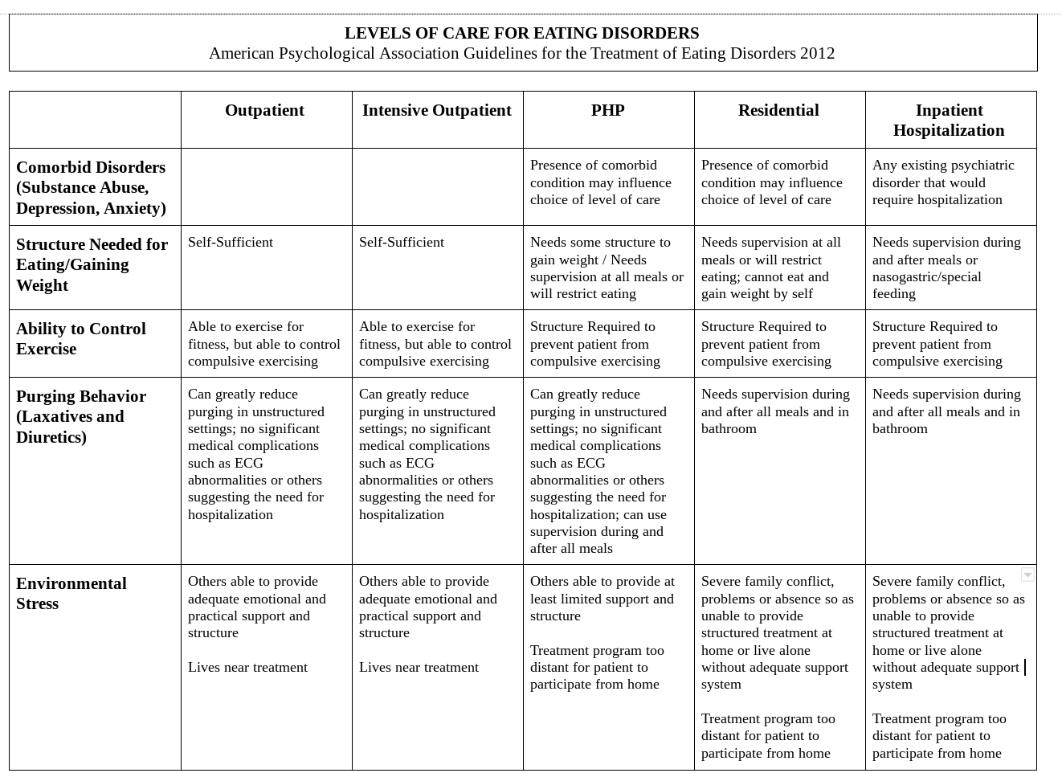

Slide 53
Evidence-Based Assessments
Assessment questionnaire
  SCOFF questionnaire
Assessment Tools
  EDI-3 Eating Disorder Inventory – 3
  EDE-Q Eating Disorder Examination Questionnaire
  BES Binge-Eating Scale

Slide 54
Should I Be Concerned?
Do you find yourself preoccupied with thoughts of food?
Do you ever eat in secret?
Does your weight affect the way you feel about yourself?
Have any members of your family suffered from an eating disorder?
Are you fearful of gaining weight or becoming fat?
Do you often feel like your eating is out of control?
Do you often avoid eating with your family, friends or in public?
Do you ever vomit or over-exercise to compensate for calories consumed?
Do you use laxatives or diet pills to help with weight loss?

Slide 55
Eating Disorder Treatment
Evidence-Based Treatment for EDs
Third-Wave CBT: DBT, ACT, CBT, RODBT (awareness of emotions and thoughts/acceptance and non-judgmental approach/identify urges/choose effective behaviors/use skills to regulate)
Accurate Levels of Care based on symptoms and physical condition/presentation
Address Co-Morbidities
Trauma/PTSD
SUD
OCD
Depression Disorders
Anxiety Disorders
Group
Family-Based Treatment

Slide 56
Why Behavioral Treatment?
Eating Disorders are Disorders of Behaviors, Cognitions, and Emotions
So, we need to monitor Behaviors, thoughts and emotions to achieve Behavior Change
Importance of Behavior Change - goals of dietary and movement (excessive and compulsive exercise and continuous movement/activity)
Treatment Guidelines from APA/NICE - Goals of eating disorder treatment -- focus on Behaviors – determines the Level of Care

Slide 57
Why Behavioral Treatment?
Eating Disorders are Mental Illnesses
Why can’t I just do insight-oriented therapy?
Overview of 3rd Wave Behavioral Therapies and Philosophies – ALL EVIDENCE-BASED
    Developed in 1990’s early 2000’s
    Awareness and Acceptance Model vs Awareness and Change Model
    (DBT) Dialectical Behavior Therapy, (ACT) Acceptance and Commitment Therapy, (MBI) Mindfulness Based Interventions, (MCT) Metacognitive Therapy
    Focuses on the process (rather than on the content of a person’s thoughts) or how a person relates to their thoughts and urges

Slide 58
Why Behavioral Treatment?
Diagnosis DSM-5 | Criteria
AN | A & B | Behaviors
 | B & C | Thoughts of Body Image, Emotions
BN | A | Behaviors
 | B & C | Behaviors
 | D | Thoughts
BED | A | Behaviors & Thoughts
 | B | Behaviors & Thoughts
 | C | Thoughts & Emotions
ARFID | A, B, C, D | Behaviors & Emotions
DSM-5 Diagnostic Criteria

Slide 59
Behavioral Therapies
CBT – Self Observational/Monitoring tools, Illogical Thoughts Awareness and Change Model
DBT – Mindfulness, Awareness, Acceptance, Behavioral Tools/Self-Monitoring Tools, Behavioral Skills
ACT – Mindfulness, Awareness, Acceptance, Defusion Skill, Values and Take Action on Values
ERP – Exposure and Response Prevention

Slide 60
Eating Disorder Thoughts
We can teach patients to become aware of their automatic, eating disordered thoughts and negative self-judgements.
  Mindfulness
We can teach someone with an eating disorder to become ego-dystonic with their eating disordered thoughts.
  Life Without Ed by Jenni Schaefer

Slide 61
Patients believe their thoughts…
Patients with some EDs have LOW motivation to change their eating behaviors.
Some Patients with EDs have HIGH motivation to change their behaviors.
We can teach patients to become aware of their automatic, eating disordered thoughts and negative self-judgements.
Thoughts can be unique or similar among the Eating Disorder Diagnoses.

Slide 62
It’s too much
It will make me fat
Oh, I just blew my diet
I can’t believe I just ate that
What the heck, I don’t care
I can’t allow myself to eat that, I don’t deserve it
I just need to lose 5 more pounds
I am sooo fat, I need to lose weight
I’m the fattest in the room
What can I eat?
What can I binge on?

Slide 63
No way, I’ll get sick
I don’t want to think about that
I’m bored
I don’t want to cook or touch food
I’ll choke if I eat that
I can’t STAND the way that smells
It will hurt me if I eat that
I’m not full
I’m not hungry right now
I don’t want to eat in front of my family
I don’t want to eat in front of strangers

Slide 64
I have PCOS and my doctor told me to lose weight
I have to be smaller
This food is unhealthy
This looks gross, don’t eat it
You have never had this, don’t try it
No, you ate a snack, no more food
I don’t deserve any food
If I’m not hungry, I shouldn’t eat
If I eat too much, I have to compensate
I can go purge in the bathroom, no one will know
I feel unloved if I don’t lose weight
I’ll die if I gain weight and get diabetes

Slide 65


Slide 66
Current Psychological Treatment Structure
Teach Mindfulness
Acceptance of Emotions/SUDS
Awareness of urges without judgement
Use Skills such as Defusion, Check the Facts, etc., for Affect Regulation
Use Skills for effective behaviors
Make choices based on values

Slide 67
DBT FLOW
EMOTIONS
FEELINGS
SKILLS
MINDFULNESS FOR AWARENESS
SUDS
BODY SENSATIONS
URGES
EFFECTIVE
BEHAVIORS
HUNGER & FULLNESS
EATING DISORDER & OTHER
SKILLS
EATING DISORDER & OTHER
THOUGHTS
EATING DISORDER & OTHER
Effective Behaviors/Treatment Goals:________________________________
Emotions
___________________________________________________
Thoughts
___________________________________________________
Body Sensations
___________________________________________________
Urges
___________________________________________________
Skills I can use:
_____________________________________________________________________________________________________________________________________________________________________________________________________________________________________________________________________

Slide 68
Evidence-Based Treatments for Adolescents with Eating Disorders
FBT: Family-based approaches have the most evidence for AN (Watson & Bulik, 2013)
FBT most effective for weight restoration in eating disorders (Lock & LaGrange, 2015)
CBT: Only 4 randomized control trials (RCT) and findings suggest including family/caregivers in treatment (Hail & LaGrange, 2018)
13 published RCTs for treatment of AN in adolescents (11/13 are family-based approaches)
Emotion Focused Family Therapy for ED in children and adolescents (Lafrance et al., 2015)

Slide 69
Evidence-Based Treatments for Adolescents with Eating Disorders
FBT leads to faster weight gain in treatment with no differences at end of treatment, therefore suggest initial FBT then some integrated model (CBT, DBT, ACT)
Outcome study suggested multifamily group statistically more beneficial than single family sessions in higher levels of care (Eisler et al., 2016)
Research Findings: the addition of family therapy improves outcomes in outpatient as well as following inpatient treatment

Slide 70
Evidence-Based Treatments for Adolescents with Eating Disorders
Transitioning the control of eating back to the adolescent (age- appropriate considerations)
Focusing treatment on adolescent developmental and psychological issues (emotional regulation) to maintain recovery and decrease relapse
Utilizing multi-family group therapy approach to increase motivation for change and relational connections vs connection with the eating disorder (Tantillo,M., Sanftner,J., & Hauenstein,E. (2013); (Tantillo,M., & Sanftner, J.L. (2010))
Parents/caregivers often blame themselves for contributing to their teen’s eating disorder and then result in unhelpful emotional responses such as: defensiveness, guilt, anxiousness and anger during treatment interventions (Whitney, et al., and Treasurer, 2005)

Slide 71
Helpful Hints When Working With Adolescents
Ask how they eat?
Ask how their dieting is going for them?
Ask are they scared of any foods or have completely cut out any food groups?
Ask if they have more, or less energy?
Ask if they exercise at night?
Ask if they are eating lunch at school?
Ask if they are eating breakfast?
Ask if they are eating any snacks?
Ask if they are on social media to learn dieting behaviors?
Ask if they are arguing with parents during meals?
Ask if a parent notices that they are eating less?
Ask if they are hiding or covering up their body?
JUST ASK!

Slide 72
Treatment Factors for Binge Eating Disorder
Prescribed medications and procedures for weight loss do not treat the psychological and behavioral symptoms of binge eating disorder
Addressing Physical Hunger
Meal Structure - 3 meals/2 snacks
For regulation of blood sugar levels
Meal Structure - eliminates physical hunger, emotional eating, obsessive thinking about food
Mindful Eating
  Increase Awareness of H,S,S
  Slows down eating
  Learn Binge-Restrict Cycle
  Learn Mindful Eating Practice - stop disconnected mindless eating

Slide 73
Treatment Factors for Binge Eating Disorder
Identifying Emotional Hunger
Emotional Hunger
Illogical Thoughts and Distorted Ideas about weight, shape, restrictive eating
Negative Emotions and Affect Regulation
  Emotion Avoidance
Emotions and thoughts that lead to choosing food as:
  Comfort
  To Numb
  To soothe
  To distract
  As important and the only piece of joy and satisfaction

Slide 74
Evidence Based Treatments for Binge Behaviors
CBT: 1ST option (Wilson ‘05; ‘10; Vocks ‘10)
  60% > abstinence
DBT: 2nd Most studied approach (Chen, 2006)
  89% stopped BE by the end of treatment
  High abstinence at 6-month follow-up
ERP: Expose to feared foods with prevention of binge or avoidance response (Steinglass ‘12; Leitenberg ‘88)
  54% 5-year abstinence (McIntosh ‘11)
  80% success at decreasing binging (Foa ‘10; Frances ‘97)
ACT: Mindfulness plus Action on Values
(Hayes ‘82; ‘05; ‘16; Harris ‘08’ Codd ‘10)

Slide 75
Any Questions?
Susan C. Mengden, PhD, CGP, CEDS-Consultant
210-253-9763
Dessimber Lauber, LVN, Intake Coordinator
210.253.9763
140 Heimer Rd, Suite 400
San Antonio, Texas 78232
Follow us on social media: @esperanzaedc
www.EsperanzaEDC.com

Slide 76
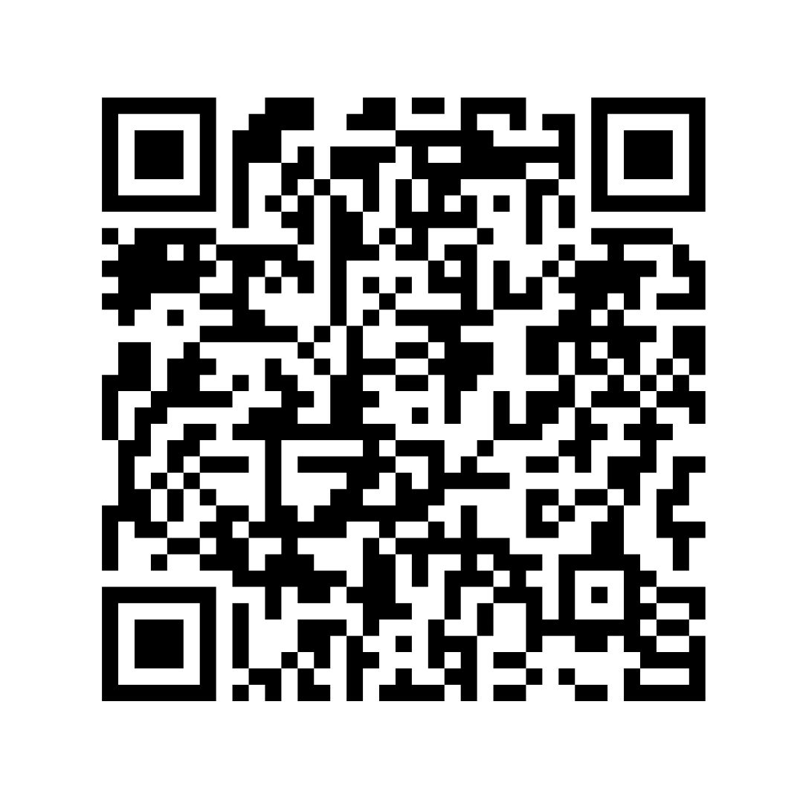
Presentation QR Code
www.EsperanzaEDC.com

