Slide 1
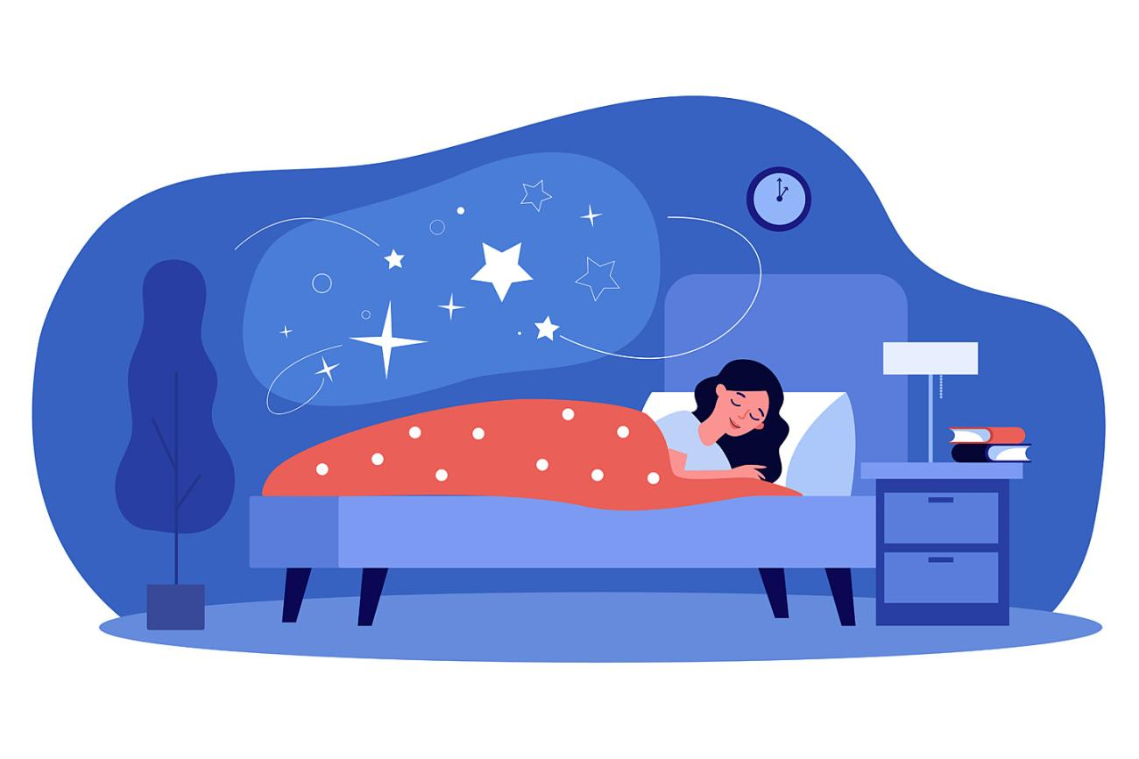
Sleep Medicine: Disorders, Diagnostic Tests, and Treatments
Abha Patel, DO
Director of Sleep Medicine
North Texas VA Medical Center
11/08/2025

Slide 2
Learning Objectives
  Be Familiar Basic Sleep Physiology & Various Sleep Disorders
  Know When to Refer to a Sleep Specialist
  Know Types of Sleep Testing and How to Interpret the Results
  How to Select Appropriate Sleep Medications
  Feel Confident Treating Sleep Disorders like Insomnia
  Become Familiar with Latest Treatment Options

Slide 3
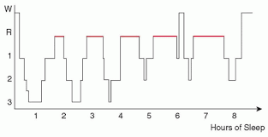
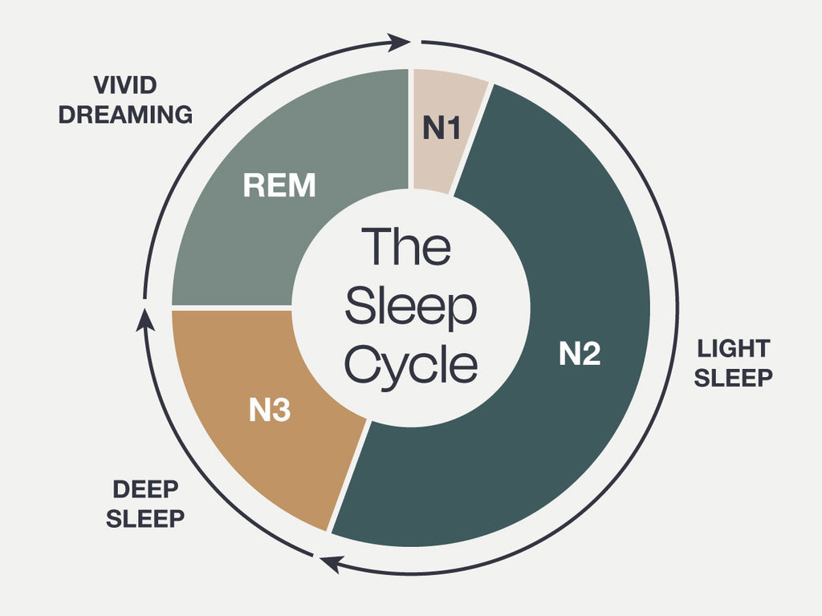
Sleep Physiology:
What Does Normal Sleep Look Like?
  Sleep Stages
  Sleep Stage Distribution
  Normal Physiologic Changes with Sleep
  Sleep Changes with Aging

Slide 4
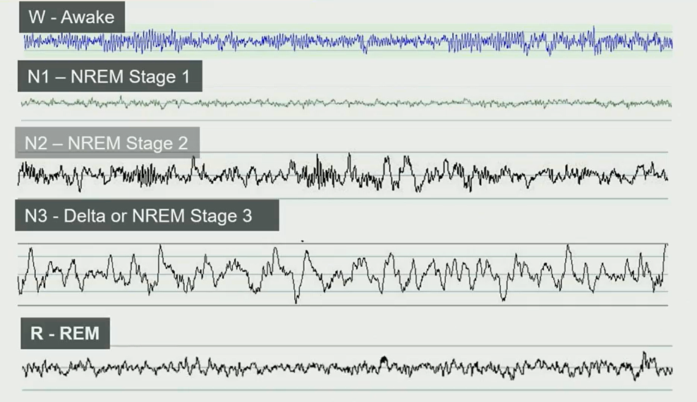
Sleep Stages on EEG – AASM Scoring Criteria

Slide 5
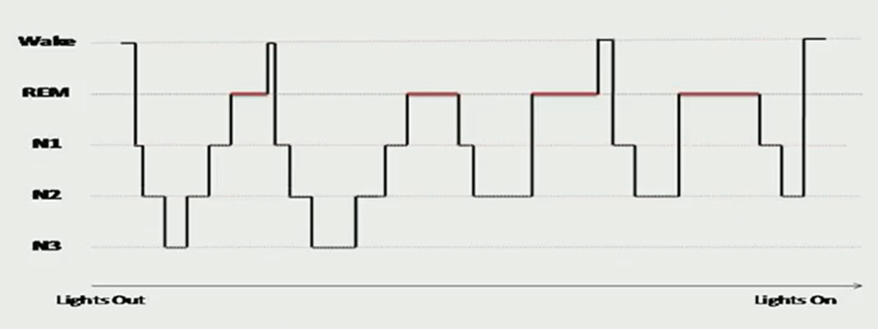
Normal Sleep Distribution: Hypnogram
NREM:
Stages N1-N3
75% TST
REM:
25% TST
Cycles every 90-120 min
↑ REM in early morning

Slide 6
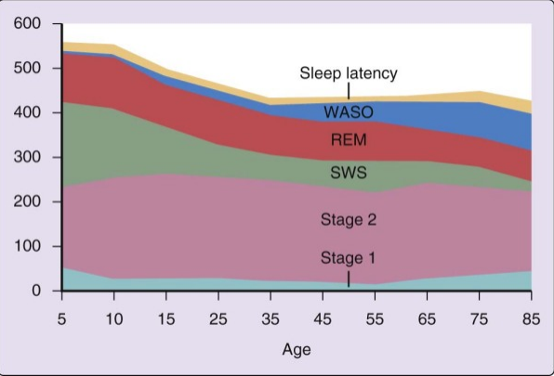
Sleep Architecture Changes with Aging

Slide 7
Normal Physiologic Changes in Sleep
CNS
  ↓ sympathetic activity
Respiratory system
  ↓ PaO2 (3-9 mmHg) & SaO2 (2%)
  ↑ PaCO2 (3-8 mmHg)
  ↓ TV and MV (1-2 L/m)
  ↓ Hypoxic & hypercapnic ventilator response (More so in REM)
  ↓ Upper airway dilator muscle tone
  ↓ Activity of accessory muscles of respiration
Cardiovascular
  ↓BP, CO, HR (during tonic REM)
GI
  ↓Swallowing rate, ES pressure, motility, salivation
Renal
  ↓GFR
Metabolic Rate
  ↓CO2 production by 10-15%

Slide 8
Types Of
Sleep Disorders
Sleep Breathing Disorders
Obstructive Sleep Apnea
Central Sleep Apnea
Obesity hypoventilation Syndrome
Upper Airway Resistance Syndrome
Other Sleep Disorders
  Insomnia
  Parasomnia
  Circadian Rhythm Disorders
  Sleep Related Movement Disorders
  Hypersomnia

Slide 9
OSA Risk Factors
Increased BMI
Male Gender
Increased Age
Bed Partner History
Witnessed apnea/Snoring (PPV 64%)
Menopause
Bony/soft tissue abnormalities

Slide 10
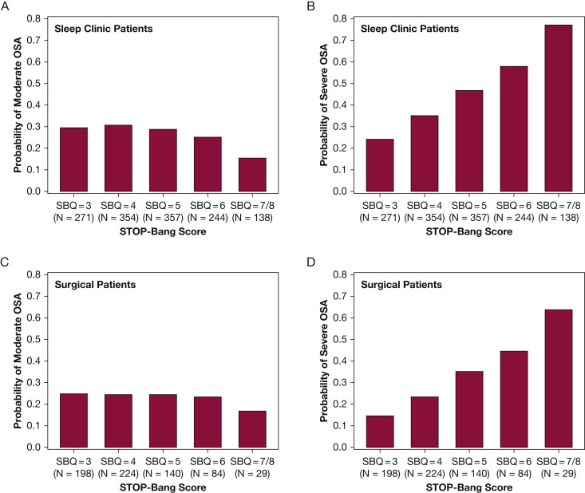
OSA Screening:
STOP-BANG
Risk stratification tool for patients with suspected OSA
  8 yes/no Questions related to clinical features of OSA
  Total score ranges from 0-8
STOP-Bang score ≥ 3
  Sensitivity of 93% to detect moderate OSA; negative predictive value of 90%
  Sensitivity of 100% to detect severe OSA; negative predictive value of 100%

Slide 11
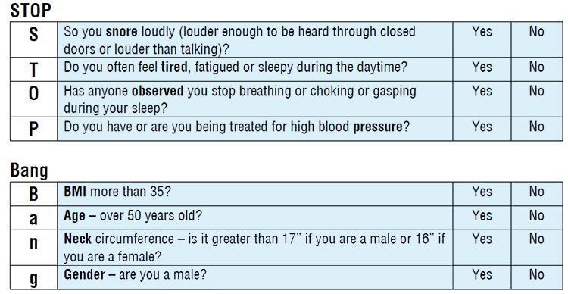
OSA Screening:
STOP-BANG

Slide 12
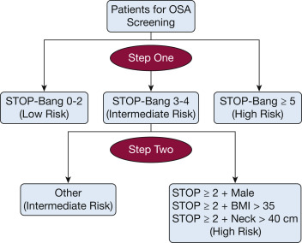
What to do with Intermediate Risk Patients?

Slide 13
Testing for OSA
Diagnostic PSG (Gold Standard)
In lab 20 channel study
Split night PSG
1st half of night diagnostic, 2nd half of night PAP titration
Titration PSG
CPAP, BIPAP, or BIPAP ST titration
HSAT (Becoming Standard Testing Option)
4 channel study – cannot stage sleep
WatchPat – can stage sleep (not as accurate as PSG)
Who can get this test?
  High suspicion for moderate to severe OSA
  No co-morbid medical or sleep disorders:
    CHF, hypoventilation, COPD, CVA, insomnia, hypersomnia, RLS

Slide 14
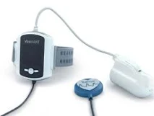
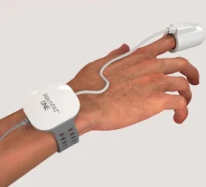
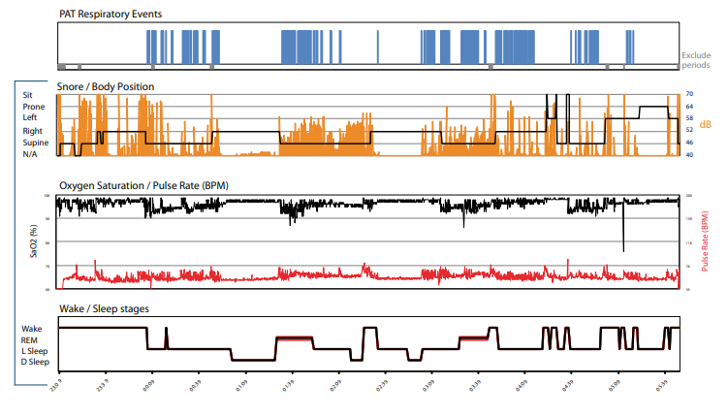
WatchPAT (HSAT)

Slide 15
Classifying OSA Severity
Apnea Hypopnea Index (AHI)
Normal = AHI < 5 events/hr
Mild = AHI 5-14.9 events/hr
Moderate = AHI 15-29.9 events/hr
Severe = AHI ≥ 30 events/hr
*3% vs 4% desaturation criteria

Slide 16
OSA: Who Do We Treat?
CMS Criteria
Moderate to severe OSA +/- symptoms
Mild OSA + symptoms
*Data for reduction of CV disease/mortality with CPAP not conclusive

Slide 17
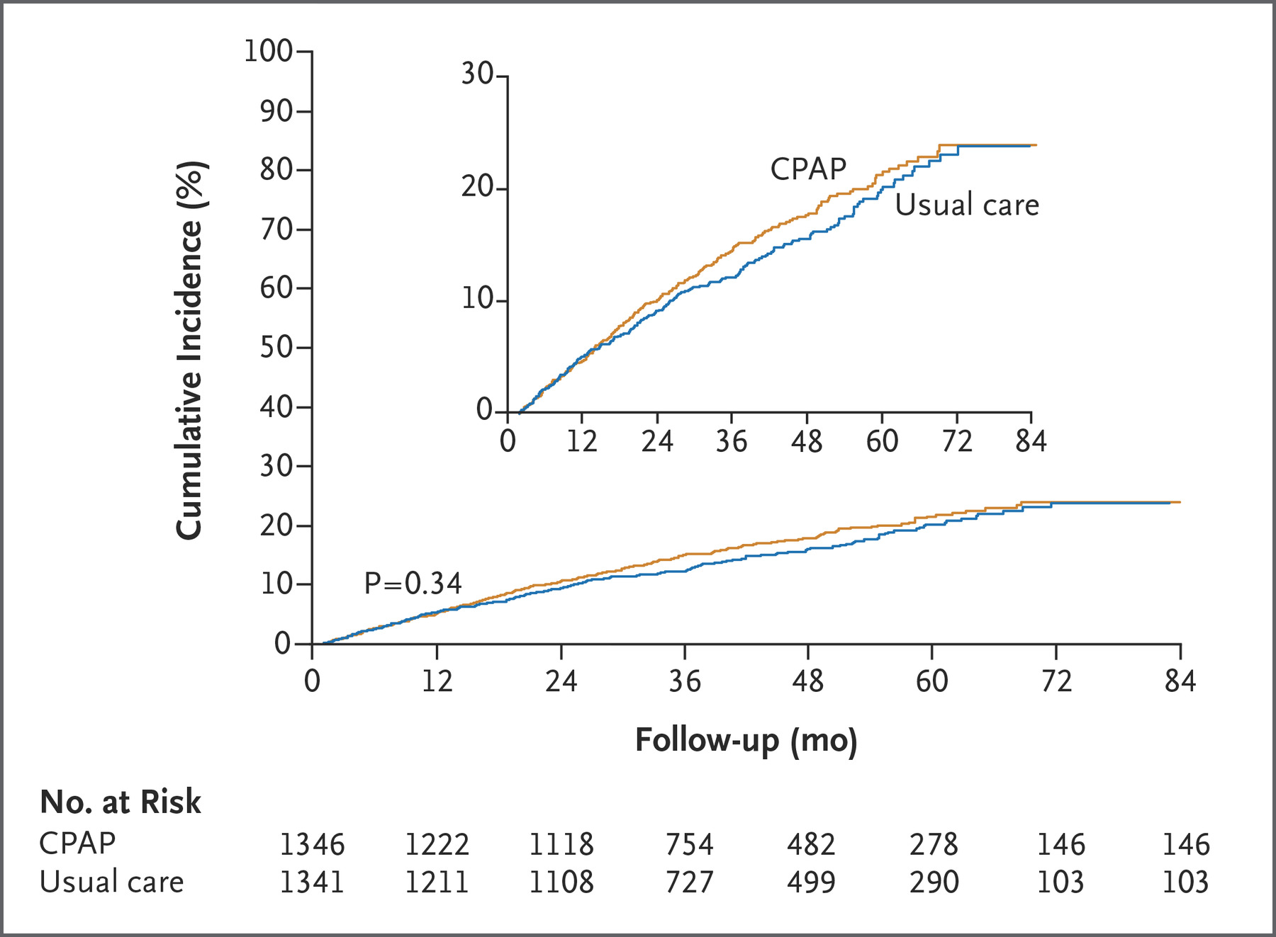
SAVE Trial
Primary End Point:
Death from CV causes, MI, CVA, or hospitalization for unstable angina, heart failure, or TIA

Slide 18
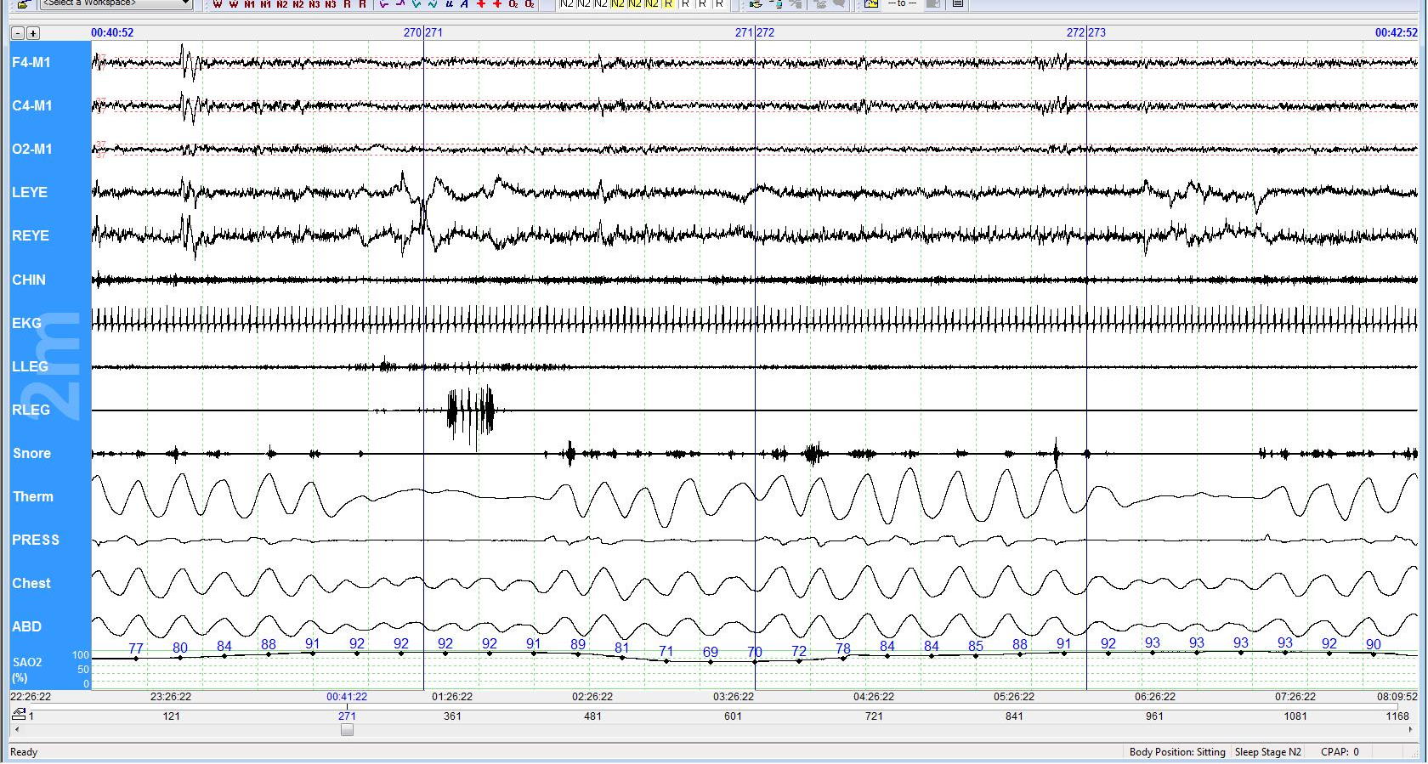
Respiratory Events on PSG
Obstructive Apnea
Obstructive Apnea

Slide 19
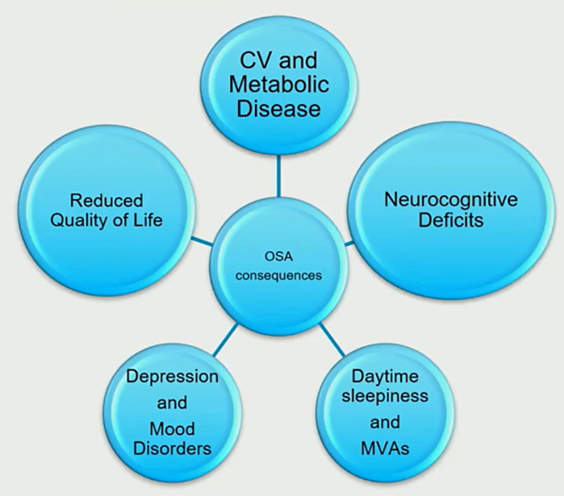
Effects of OSA

Slide 20
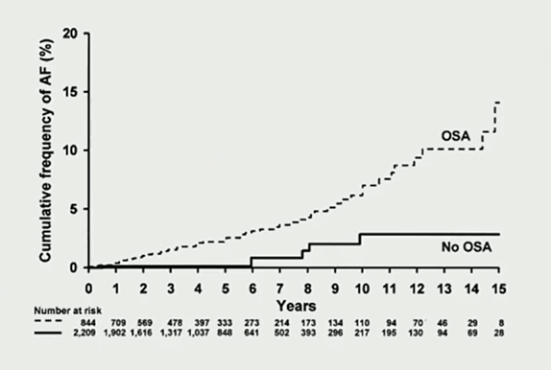
OSA & Atrial fibrillation
Journal of American College of Cardiology (2007)
Retrospective study on 3542 pts with PSG
133 developed AF
OSA predictive in those < 65 y/o

Slide 21
OSA & Hypertension
WSC
Assessed 1,060 men and women age 30-60
Linear relationship between HTN and OSA severity
Risk of HTN increased by 4% for every 1 event/hr increase in AHI
SHHS
Older cohort of patients (>40)
Cross sectional analysis of 6,132 pts
Increased risk of HTN for AHI > 30 (OR 1.37, 95%CI, 1.03-1.83)

Slide 22
OSA:
Cardiovascular Risk
Increased risk of
Hypertension
2.3x increased risk of incident stroke
A. fib, bradyarrhythmia, PVCs
CAD
Heart failure
All cause mortality (Busselton health Study)
*Risk is associated with OSA severity and degree of O2 desaturation events
*Risk of death from OSA decreases after age 65

Slide 23
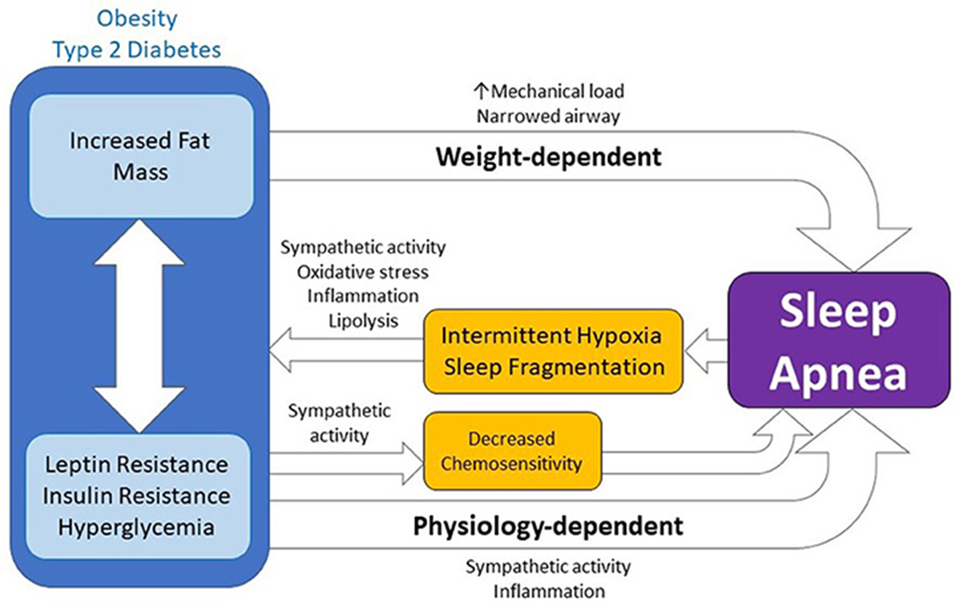
OSA: Metabolic and Neurovascular Effects
Increased risk of
Glucose intolerance and insulin resistance
Central obesity / abdominal fat accumulation
Difficulty losing weight
Cognitive dysfunction

Slide 24
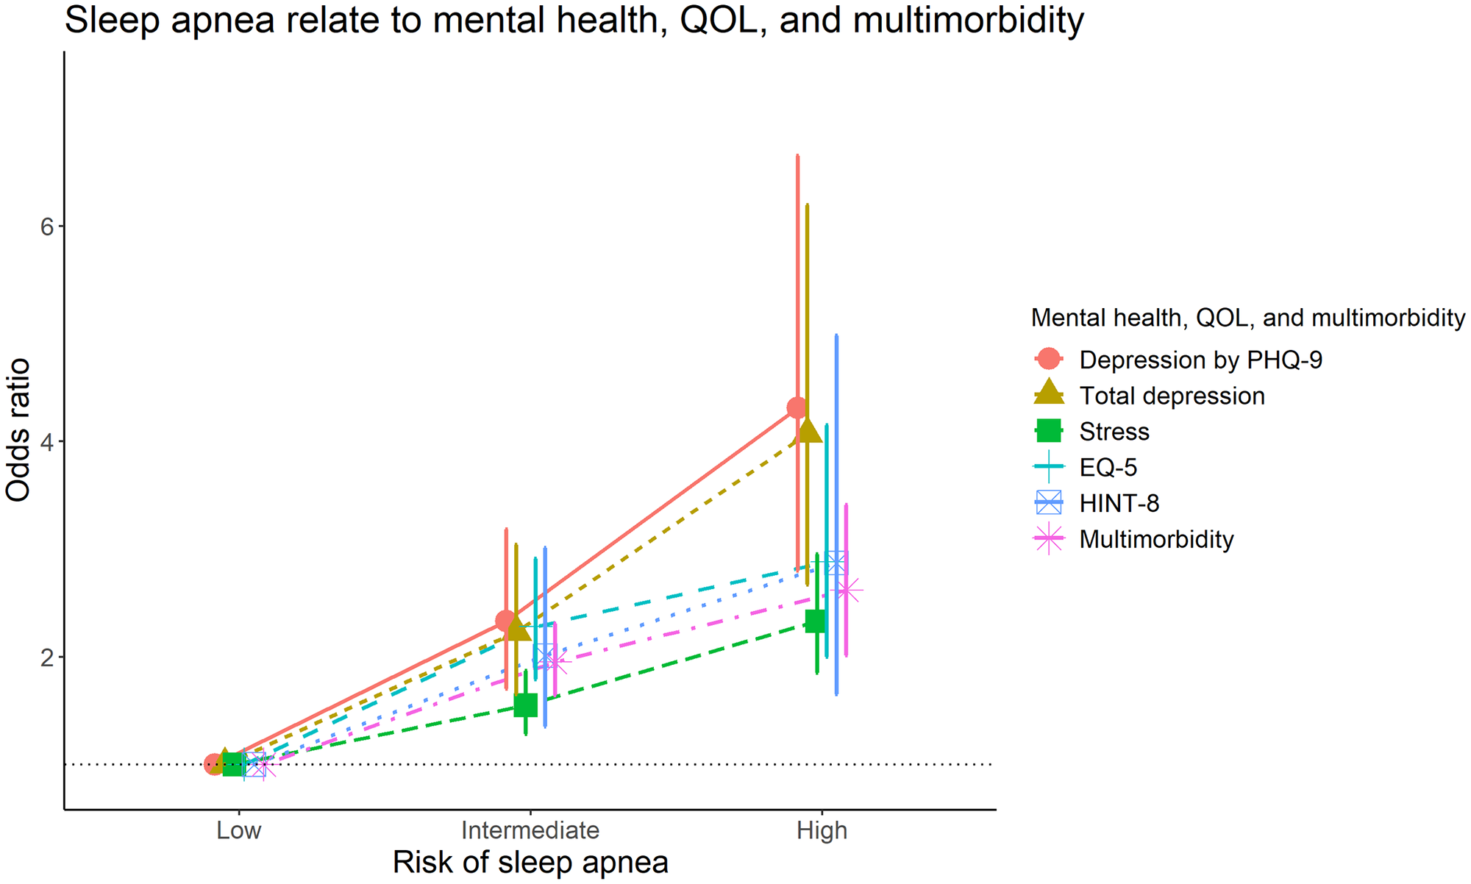
OSA Effects on Mental Health
2023 Study from Korea
8030 patients reviewed
Screening for OSA using STOP Bang Questionnaire
Screened for Depression using PHQ-9

Slide 25
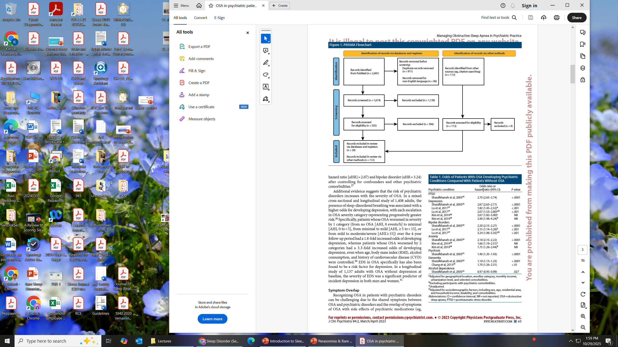
Managing OSA in a Psychiatric Practice

Slide 26
Managing OSA in a Psychiatric Practice

Slide 27
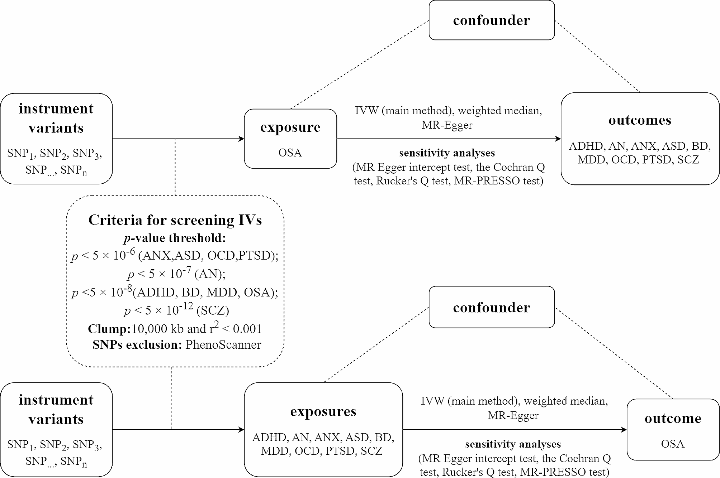
OSA and Mental Disorders: A Bidirectional Mendelian Randomization Study

Slide 28
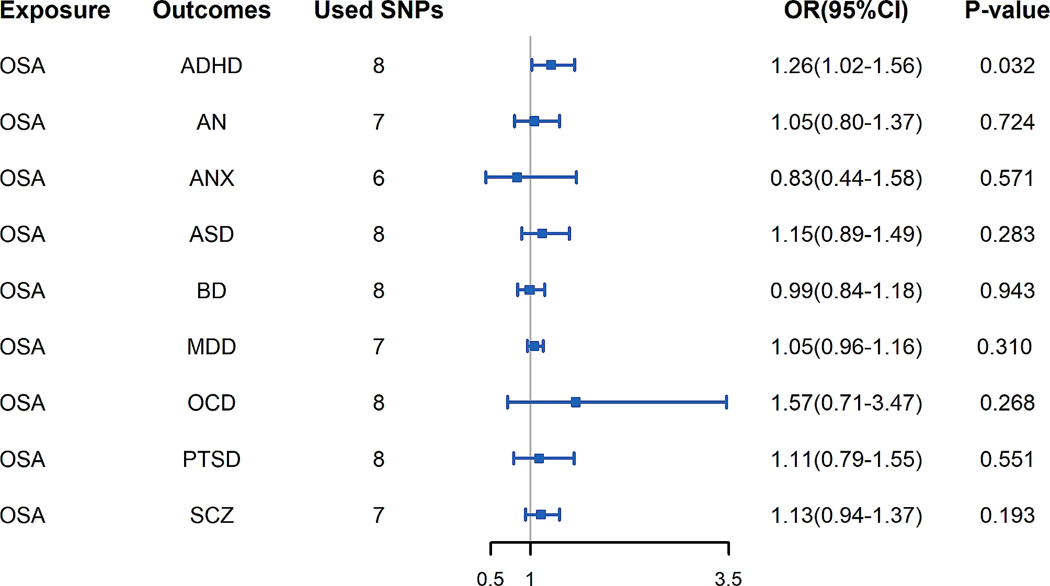
Genetically Predicted OSA on Mental Disorders

Slide 29
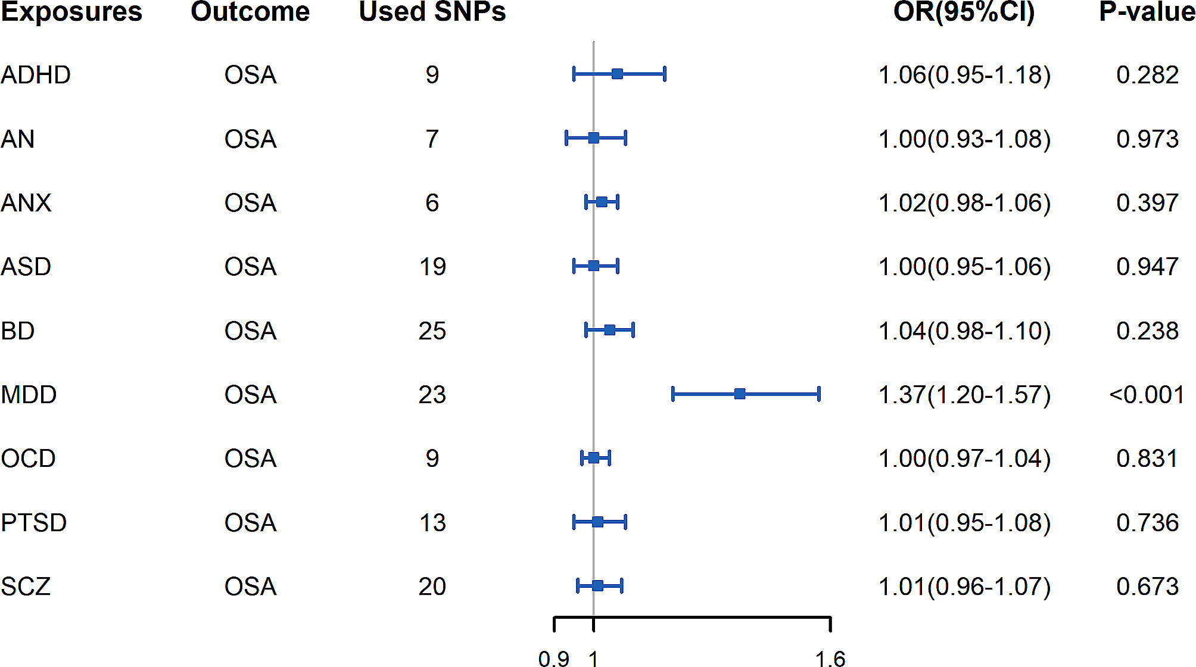
Genetically Predicted Mental Disorders on OSA

Slide 30
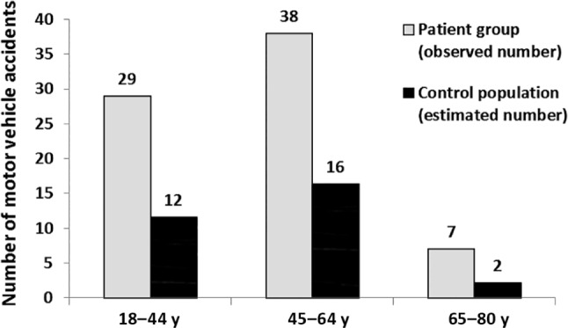
OSA: Other Effects
Increased risk of
Anxiety / Depression
Worsen QOL
Sexual dysfunction
Nocturia
MVA (2.5x higher)
Health care utilization

Slide 31
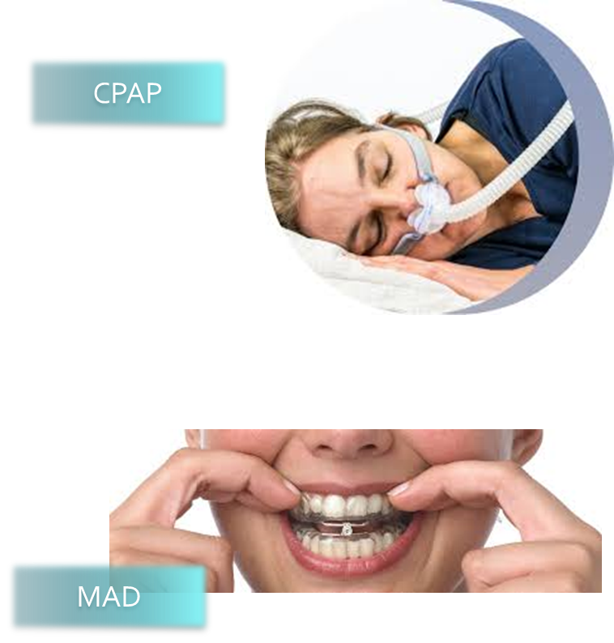
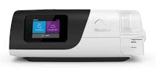
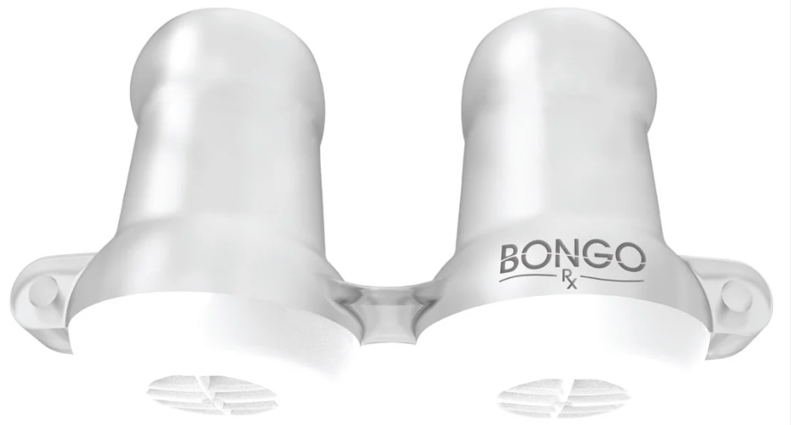
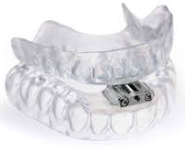
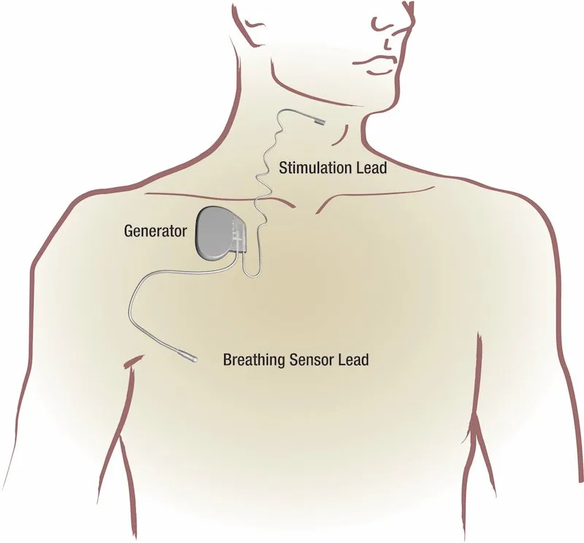
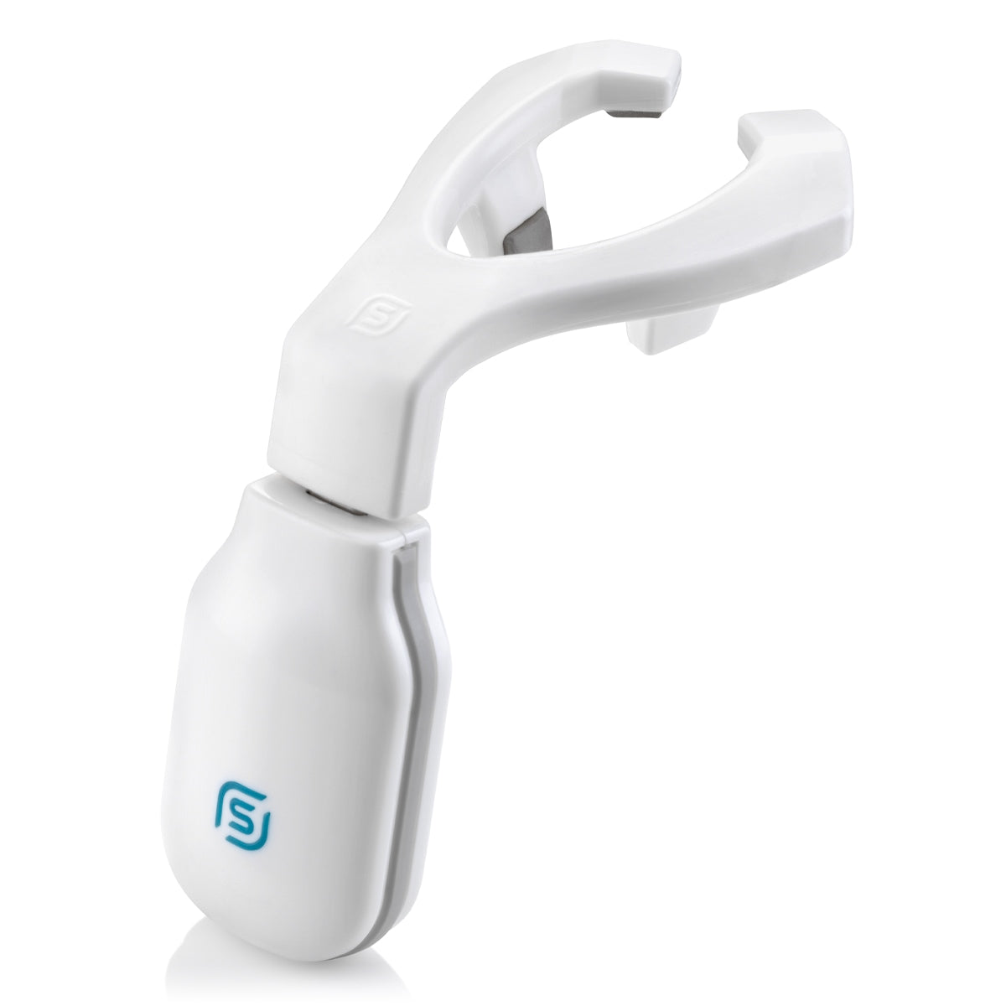
Treatment for OSA
PAP therapy
Positional Therapy
Oral Appliance
EXCITE OSA
BongoRx
Medications
Surgery
UUUP / LAUP
MMA
T&A
HGNS
Bariatric surgery

Slide 32
CPAP Therapy
CPAP
Settings: 4-20 cm H2O
CPAP Adherence
CMS criteria: > hours usage 70% of all nights
General adherence: 50%
Factors to help improve usages:
  Heated humidification
  Education
  CBT
  Sleep specialist referral

Slide 33
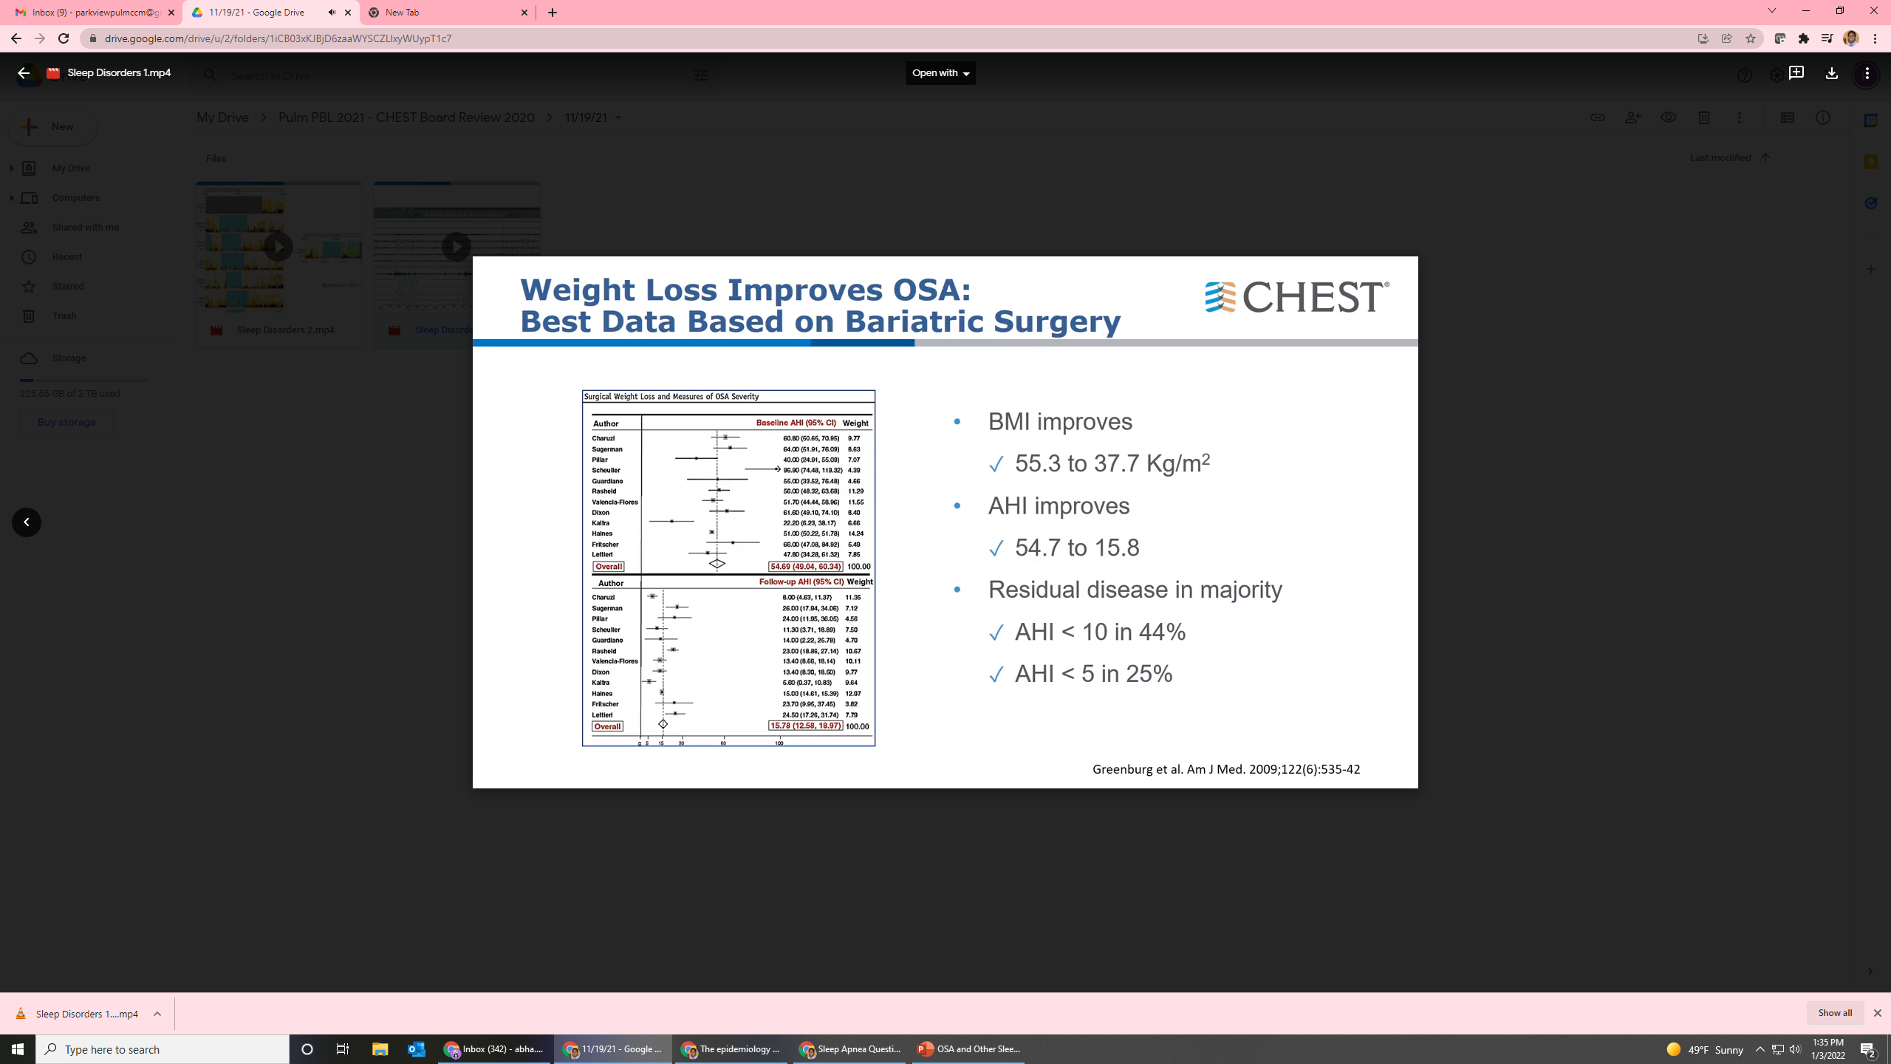
Meta-analysis for Surgical Weight Loss to Treat OSA
Data
12 studies, 342 patients
Pooled mean BMI reduced by 17.9 kg/m(2)
Pooled baseline AHI reduced by 38.2 events/hr

Slide 34
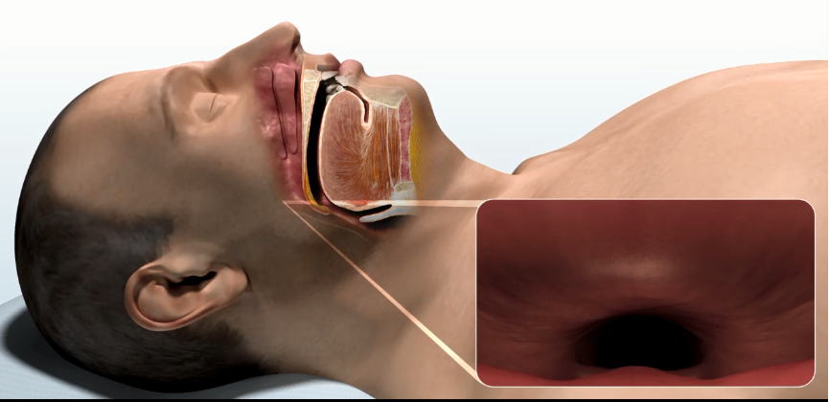
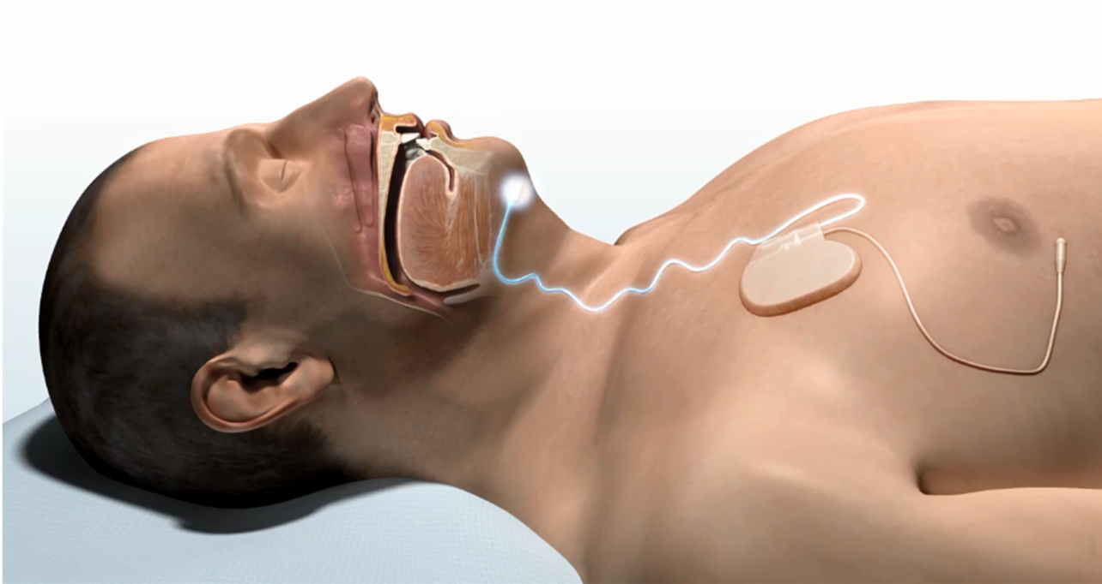
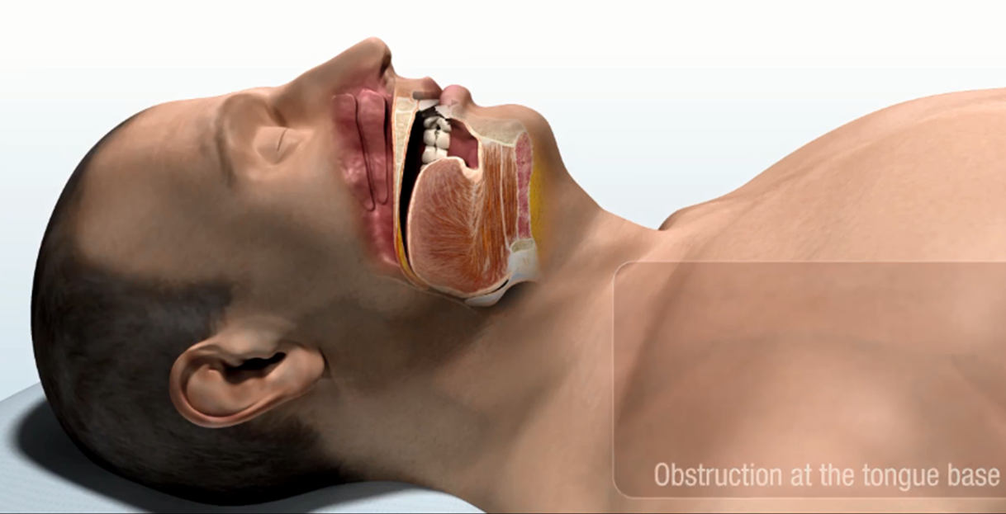
Hypoglossal Nerve Stimulator: Inspire

Slide 35
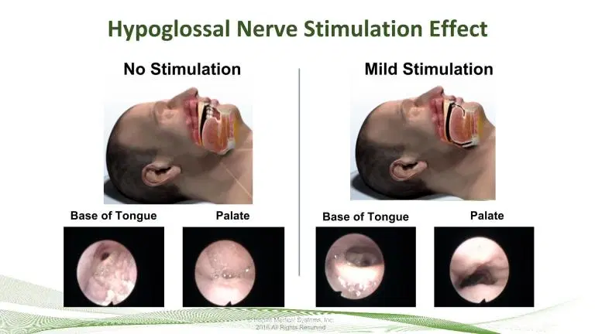
Hypoglossal Nerve Stimulator: Inspire
STAR Trial
Reduced AHI by 68% (AHI 29.3 → 9)
Sustained effect

Slide 36
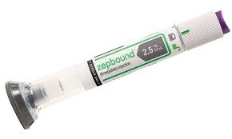

Emerging Treatments for OSA
ZEPBOUND
AD109

Slide 37
Types Of
Sleep Disorders
Sleep Breathing Disorders
Obstructive Sleep Apnea
Central Sleep Apnea
Obesity hypoventilation Syndrome
Upper Airway Resistance Syndrome
Other Sleep Disorders
  Insomnia
  Parasomnia
  Circadian Rhythm Disorders
  Sleep Related Movement Disorders
  Hypersomnia

Slide 38

Insomnia: A Public Health Burden
Increased Cost to Society
  Work absenteeism
  Health care costs
Increased Health Concerns
  Altered cognition
  Emotional disturbances
  Decrease QOL
Common Complaints Associated with Insomnia
  Poor energy/motivation
  Irritability
  Daytime sleepiness
  Physical discomfort

Slide 39
Insomnia: A Change in Definition
DSM V
Published in 2013
Changed from Primary Insomnia to Insomnia Disorder
STAR*D Trial
Pts with MH related insomnia treated with citalopram
54.9% of remitters continued to have mid-nocturnal insomnia
71.7% reported continued sleep disturbances

Slide 40
Insomnia Definitions and Diagnosis
Chronic
3 episodes per week for at least 3 months
Short term
Symptoms occur 2/2 an identifiable stressor
Physical, physiologic, psychosocial, interpersonal
Typically last days to weeks
Ongoing for < 3 months

Slide 41
Insomnia Classifications
Chronic
  Primary
  Secondary
  Co-morbid
Short term
  Adjustment
  Acute
Previously classified as:
Psychophysiological
Idiopathic
Inadequate sleep hygiene
Paradoxical
Insomnia due to a mental disorder
Behavioral insomnia of childhood
  Limiting setting
  Sleep Onset
  Combined Type
Insomnia related to drug, substance, or medication use
Insomnia related to a medical condition

Slide 42
Insomnia: Diagnostic Testing
Clinical Diagnosis
Clinical history
Objective Data
Actigraphy Testing
Screening Questionaries (ISI)
Personal Wearable Devices

Slide 43
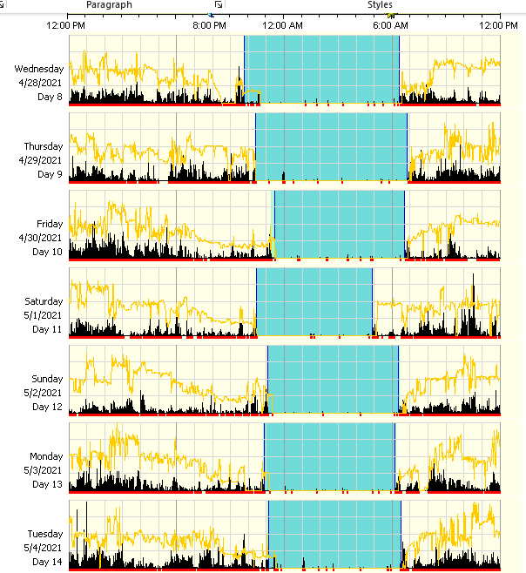
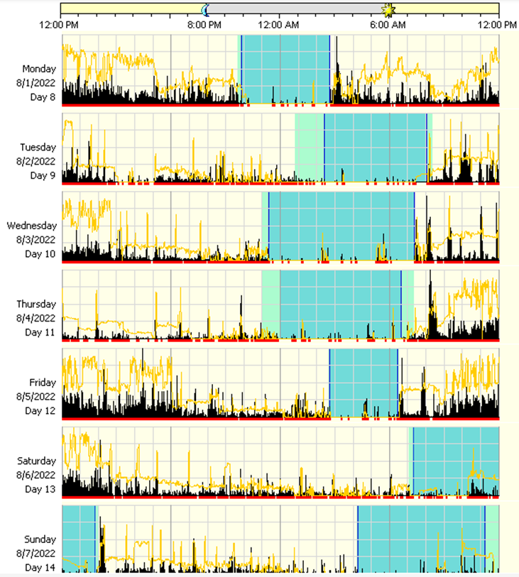

Slide 44
Insomnia: How Medications Change Sleep Perception and Quality
Medication Effect on Sleep Architecture
  Sleep duration often remains unchanged or increases
  Deviations from nml sleep architecture can lead to sleep fragmentation
    Results in a sense of having nonrestorative sleep
  Sedative hypnotics can distort sleep architecture

Slide 45
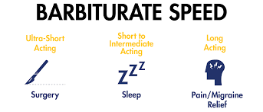
FDA Approved Medications for Treatment of Insomnia
Benzodiazepines
  Doral (quazepam)
  Estazolam
  Flurazepam
  Halcion (triazolam)
  Restoril (temazepam)
Non-Benzodiazepine receptor agonists
  Lunesta (eszopiclone)
  Ambien (zolpidem)
  Sonata (zaleplon)
TCA
  Silenor (doxepin)
Melatonin Agonist
  Rozerem (ramelteon)
  Hetlioz (tasimelteon)
Orexin antagonist
  Belsomra (suvorexant)
  Dayvigo (lemborexant)
  Quviviq (daridorexant)
Barbituates
  Butisol (butabarbital)
  Seconal (secobarbital)
Generally NOT recommended due to side effect profile and abuse potential

Slide 46
Non-Benzodiazepine Receptor Agonists
Eszopiclone (Lunesta)
½ life 6 hrs → only use in pts who can get 7-8 hrs sleep
Adverse events: Metallic taste, HA, somnolence, dizziness
2014: FDA warning for driving or other next day activities
Zolpidem (Ambien)
1.5 – 2.4 hrs ½ life
CR formulation: ½ life 1.6 - 4 hrs
Adverse events: Parasomnia, HA, somnolence, dizziness
2014: FDA warning for driving or other next day activities → lower doses recommended
Zaleplon (Sonata)
½ life 30 min – 1 hr (delayed absorption with heavy meals or high fat meals)
Should be avoided in pts with hepatic failure

Slide 47
Insomnia: The Dark Side of BZD and Z-Drugs
BZDs
Hangover effects
Cognitive / memory impairment
Car accidents (5-10%)/ falls
Risk of abuse / dependence → leads to chronic use
Z-drugs
BZD / Z drugs doubles the risk of MVA
Dependence, next day cognitive, memory, psychomotor, balance impairment

Slide 48
Insomnia: Receptor Mediated MOA of Hypnotics
GABA Receptor
  Chief inhibitory neurotransmitter (BZD and Z drugs act on) → Most studied GABA_{A}
  Main difference b/w BZD and Z drugs is the affinity to GABA_{A} subunits
    BZD → equal affinity to GABA_{A} subunits α1, α2, α3, α5 receptors
    Z drugs → higher affinity to GABA_{A} subunits α1 receptors
      GABA_{A} subunit α1 is affiliated more strongly with sleep, not anxiety
      Zaleplon, zopiclone, and zolpidem high affinity for α1
      Eszopiclone has high affinity and potency for α2 and α3 subunits

Slide 49
Off Label Medications for Insomnia
NOT ideal without co-morbid psychiatric indications due to side effects
Antidepressants
  Trazodone
  Mirtazapine
TCA
  Amitriptyline
  Nortriptyline
  Imipramine
Atypical Antipsychotics
  Quetiapine
  Olanzapine
  Risperidone
Inhibits 50% of 5-HT_{A} receptors in brain at low doses (10 mg):
start at 25-50 mg, increase to 100 mg
Anticholinergic effects at higher doses
H₁ antagonist, typically dose at 30 mg
Sedating effects 2/2 broad receptor antagonistic effect
Anticholinergic effects, orthostatic hypotension, slowed cardiac conduction
Sedating effects 2/2 antagonistic effect on 5-HT₂ & H₁ receptors
Metabolic syndrome & extrapyramidal symptoms

Slide 50
Insomnia: Antidepressants
Amitriptyline
TCA → strong SERT, mod NET
Mirtazapine
Novel noradrenergic/serotonergic antidepressant
Trazodone
34% more rx than most prescribed FDA approved med
Hypnotics effects via H1/2 receptor antagonist
FDA approved for MDD
Limited data looking at tx of insomnia
2ndry insomnia = 2 studies
↑TST, ↑SWS, ↓ REM
Hypnotics effects via H1 receptor blockade
FDA approved for MDD
Mean ½ life 22.4 hrs, active metabolite nortriptyline (1/2 life 26 hrs)
Limited data looking at tx of insomnia
Weak evidence for use in insomnia disorder based on 1 case series
Improved SL with concomitant melatonin
Hypnotic effect 2/2 mod blockage of H1 receptor and partial agonism at 5HT1A receptor, antagonism at 5HT1C/2 receptors
FDA approved for depression
1 RCT: compared Ambien vs trazodone vs placebo
SL ↓ Ambien > trazodone > placebo

Slide 51
Insomnia: Anticonvulsants
Insomnia: GABAergic Agents
Gabapentin
Anticonvulsant, binds to a2delta subunit of voltage sensitive Ca channels
Pregabalin
Similar MOA to gabapentin
Hypnotic/anxiolytic effect via modulation of GABAergic and glutamatergic systems
1 Open label study for primary insomnia
PSG evidence of ↑SWS, ↑SE, and ↓WASO
RCT in pts with insomnia + EtOH dependence
GABA = ↑TST, 40% less EtOH relapse, no change in SL
Greater bioavailability
No studies assessing primary insomnia
2 RTC = improved symptomatic insomnia in patients with anxiety

Slide 52
Insomnia: Atypical Antipsychotics
Olanzapine
MOA: Affinity for D1/2/4 R, 5-HT2A/C/3 R, H1
Quetiapine
MOA: Lowest affinity for D2
Hypnotic s effects due to H1 effects
No studies for primary insomnia
May be useful for insomnia related to PTSD or paradoxical insomnia
1 RCT = not better than placebo

Slide 53
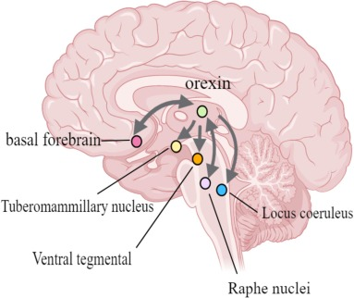
Insomnia: Receptor Mediated MOA of Hypnotics
Orexin Receptors
  Pair of excitatory neuropeptide hormones produced exclusively by neurons in the lateral hypothalamic area
    OXA and OXB bind to OX1 and OX2 receptors
  Orexinergic system promotes behavioral arousals, ↑ food intake, and locomotor activity
  Orexins also regulate stress response: ↑ activity of HPA
  Selective blockade of OX2 ↑ REM & NREM
Orexin

Slide 54

Insomnia: Orexin Receptor Antagonists
Suvorexant
Selective antagonist of OX1R & OX2R
Lemborexant
Daridorexant
Approved for sleep onset or sleep maintenance insomnia
Less drug absorption at higher doses → better tolerated at 15-20 mg
RCT data: Improved subject SL and TST
Similar effect compared to BZDs, Ramelteon, sedating antidepressants

Slide 55
Insomnia: Melatonergic Drugs
Ramelteon
Selective agonist at MT1 & MT2 receptors
Tasimelteon
Selective agonist at MT1 & MT2 receptors
Hypotonic effect mediated by long lasting agonism of MT receptors
1/3 studies demonstrated improved SL, no effect on other sleep parameters
Approved for treatment of non-24-hour sleep wake disorder
Phase II RCT: ↓SL, ↑SE, shifted plasma melatonin rhythm to an earlier hour
Do NOT take with food

Slide 56
Insomnia: Antidepressants
Low dose Doxepin
  TCA with significant anti-histaminic effect
  800x more potent at H1 receptor than Benadryl
  At low dose, effects confined mainly to H receptor
  Single night RCT: ↓SL, ↑TST

Slide 57
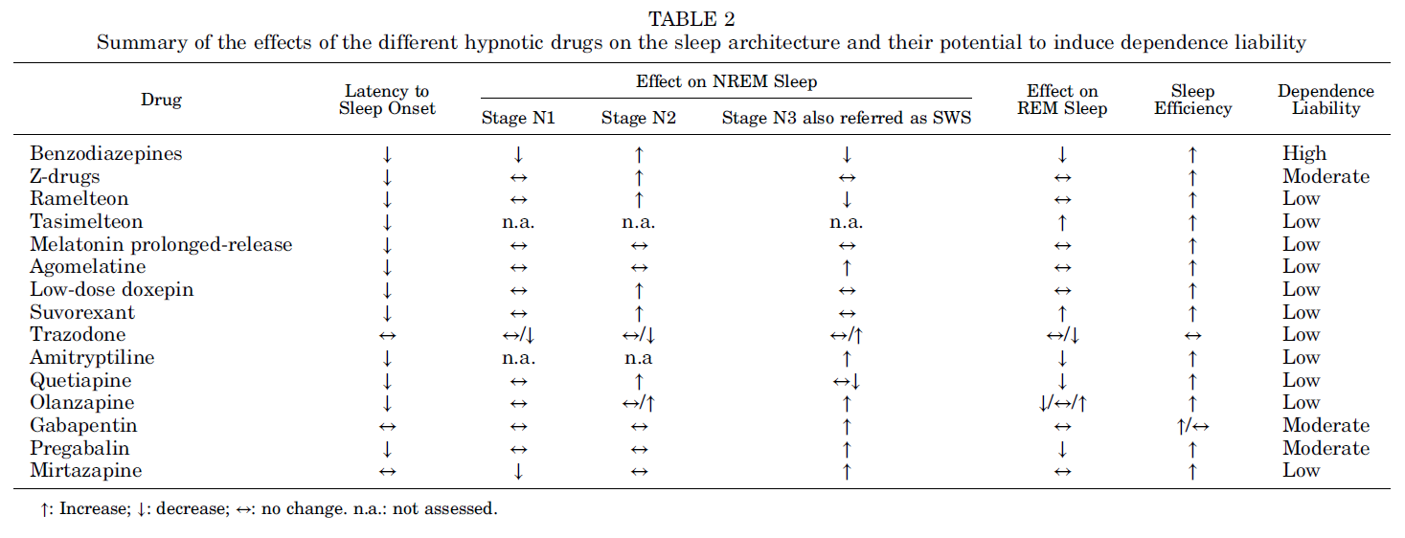

Slide 58

Insomnia:
Up and Coming
Adenosine Receptor Agonist
YZG-331 → promising as a sedative hypnotic
Adenosine analog that binds to receptor site
Casein Kinase-1d/e
Essential elements of molecular oscillators (circadian clock)
Inhibitors may be utilized to treat sleep disorders
Selective Melatonin MT2 Receptors
MT 1 & MT2 have opposing / complementary fxn
MT2 activation promotes SWS
MT1 activation decreases SWS and increases REMS
UCM765 & UCM924 → Increase SWS without decreasing REMS
Selective Orexin-2 Antagonist
Seltorexant and JNJ-48816274 → Only Orexin 2 is involved in the regulation of sleep
May preserve sleep architecture to a greater extent than dual orexin receptor antagonists

Slide 59
Insomnia: Changes with Aging
Sleep Architecture
  ↑ Sleep latency
  ↑ Sleep fragmentation
  ↓ SWS
  ↓ Sleep efficiency
How does this effect insomnia?

Slide 60
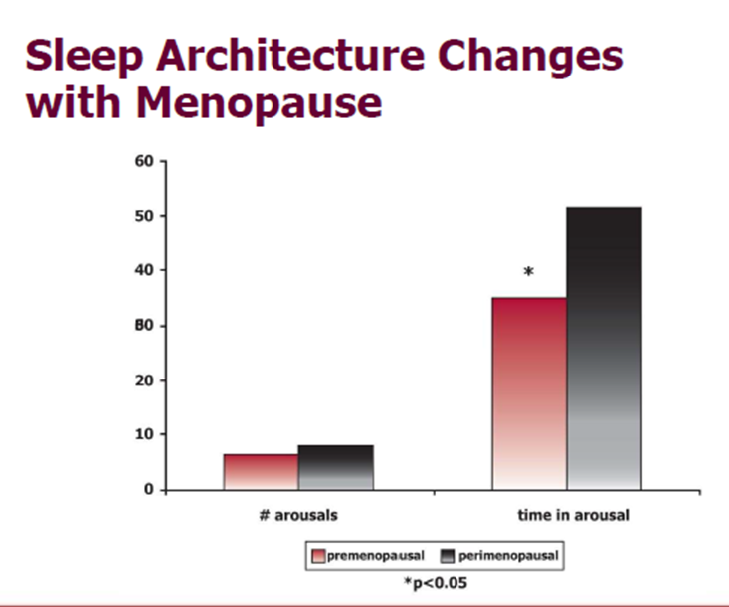
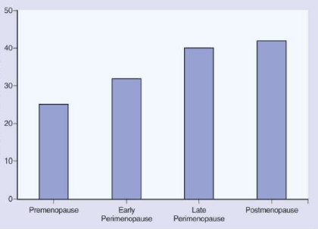
What Happens to Sleep As We Age?
J Psychosom Res, Volume 43, Issue 4, 1997
Prevalence of sleep maintenance difficulty in women (%)
Premenopause
Early
Perimenopause
Late
Perimenopause
Postmenopause
Kryger, Roth 6th Ed.

Slide 61
Non – Pharmacologic Treatments of Insomnia
Improve Sleep Hygiene
Bedtime routine
Caffeine consumption
CBT-I
Cognitive behavioral therapy aimed specifically at improving insomnia
Treat Underlying Sleep Disorders
OSA
RLS
Circadian Rhythm Disorders
Alcohol consumption

Slide 62
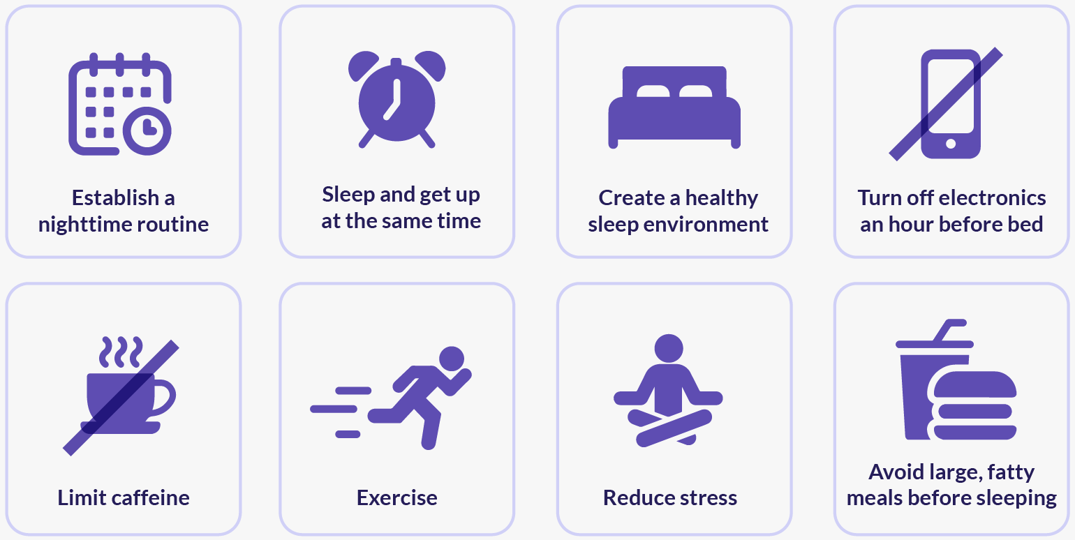
What is Good Sleep Hygiene?

Slide 63
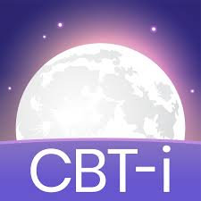
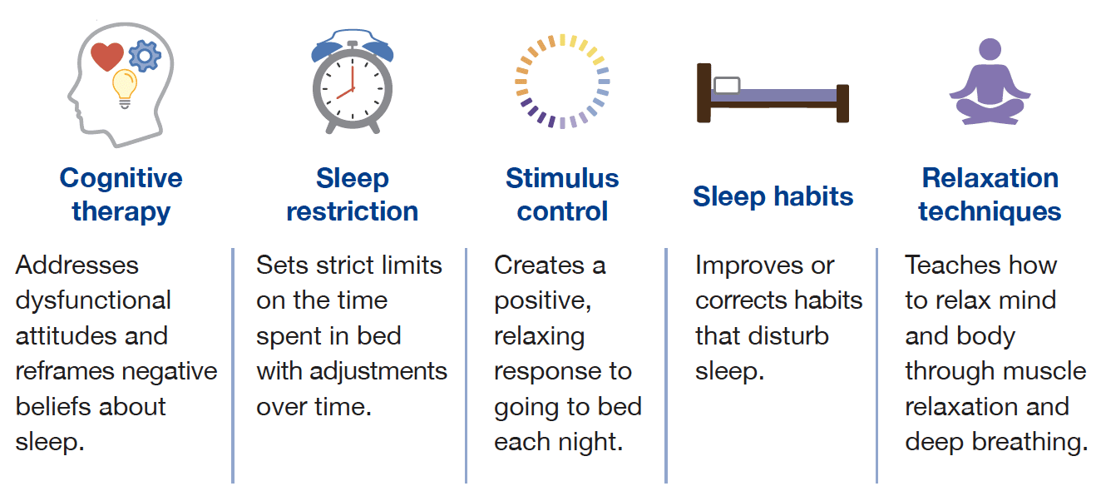

CBT-I Therapy for Insomnia
Phone Applications for CBT-i

Slide 64
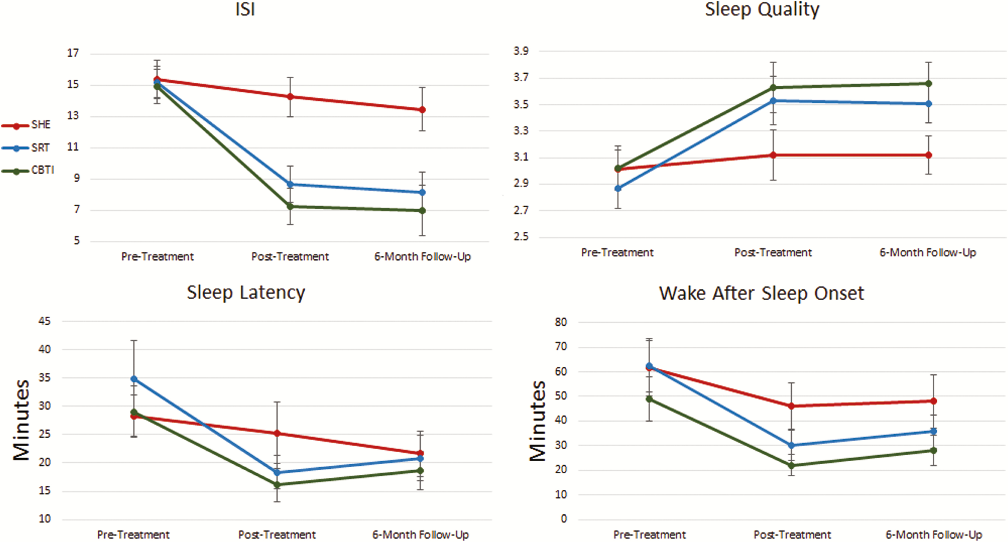
Treatment Effects of CBT-I, SRT, and SH
Sleep Hygiene (SH)
Sleep Restriction Therapy (SRT)
Cognitive Behavioral Therapy for Insomnia (CBT-I)
Sleep, Volume 42, Issue 2, February 2019

Slide 65
Types Of
Sleep Disorders
Sleep Breathing Disorders
Obstructive Sleep Apnea
Central Sleep Apnea
Obesity hypoventilation Syndrome
Upper Airway Resistance Syndrome
Other Sleep Disorders
  Insomnia
  Parasomnia
  Circadian Rhythm Disorders
  Sleep Related Movement Disorders
  Hypersomnia

Slide 66
Parasomnias
Defining Parasomnia
Undesirable physical event/experience that occurs during entry into sleep, within sleep, or arousals from sleep
Pathophysiology of Parasomnia
The sleep wake transition is not a complete on-off switch phenomenon, but a period of gradual transition
Classification of Parasomnia
REM
Non-REM
Other
During the transition period of re-organization, parasomnia can occur due to a dissociation of normal sleep and wake transitions

Slide 67
Parasomnia Classifications
REM Parasomnia
RBD
NREM Parasomnia
Rare Sleep Disorders
Sleep Paralysis
Nightmare Disorder
Somnambulism
Somniloquy
Sexsomnia
Sleep Related Eating
Catathrenia
Nocturnal Frontal Lobe Epilepsy
Confusional Arousals
Exploding Head Syndrome

Slide 68
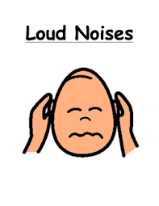
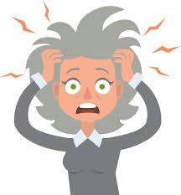
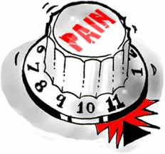
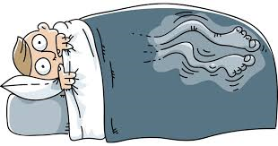
Precipitating Factors
Sleep Depreivation
Forced Arousals
Co-Morbid
Dx
Rx
Stress
Sleep
Dx

Slide 69
Disorders of Arousal
Typically emerge from N3 sleep
Predilection for 1st third of the night
More common in children
Decrease in frequency with age
Amnestic or poor event recall
Non stereotypic behavior

Slide 70
NREM Parasomnia
Somnambulism
Manifests in walking around in an altered state with impaired judgement
Somniloquy
Confusional Arousals
Considered a common benign variant of parasomnia
Confusional behavior during or after arousals from sleep
Prevalence: 17% in childhood, peaks at age 12
Frequency decreases with age, but 3% adults continue to have disorder
Safety and legal implications
Can mimic NFLE
Common in both children and adults
Occur most often out of N3 sleep
Most patients will outgrow the disorder
Prevalence: 17.3% in children age 3-13; 6.9% in children over 15 to adulthood

Slide 71


Slide 72
REM Parasomnia
REM Behavior Disorder
Associated with alpha-synucleopathies
Nightmare Disorder
Isolated Sleep Paralysis
Occurs in the last third of the night
Inability to move on awakening
Associated with mild autonomic discharge
MSA, DLB, PD
Classically seen in men > 50 (prevalence 0.5%)
Can result in injury
Tx: Melatonin or clonazepam (Alprazolam)
In teens/young adults → Associated with EtOH, brainstem tumors, MS, SSRI use, narcolepsy
Lack of REM atonia
Can occur normally at least once in a lifetime (40-50%)
Arousal is associated with paralysis of skeletal muscle (except diaphragm and EOM)
Episodes can last up to a few minutes and improve spontaneously
RISP: Tx with
Tx with reassurance
Cognition remains intact
Patient’s often have an amnestic component

Slide 73


Slide 74


Slide 75

Sleep Terrors vs Nightmares

Slide 76
Types Of
Sleep Disorders
Sleep Breathing Disorders
Obstructive Sleep Apnea
Central Sleep Apnea
Obesity hypoventilation Syndrome
Upper Airway Resistance Syndrome
Other Sleep Disorders
  Insomnia
  Parasomnia
  Circadian Rhythm Disorders
  Sleep Related Movement Disorders
  Hypersomnia

Slide 77

Typical Circadian Cycle

Slide 78

Two-Process Model of Sleep
Borbely AA: A two process model of sleep regulation. Hum Neurobiol 1:195-204, 1982.

Slide 79

Temperature – Melatonin Curves
Borbely AA: A two process model of sleep regulation. Hum Neurobiol 1:195-204, 1982.

Slide 80
Thermoregulation During Sleep
Sleep occurs during the falling phase of the temp rhythm
  After CTmax Cool Down to Sleep
Waking occurs during the rising phase of the temp rhythm
  After Ctmin Heat Up to Wake Up

Slide 81

Location of the Clock

Slide 82

Effects of Circadian Clock
24.2 h circadian rhythm entrained to a 24 h day by Zeitgebers
  Non-photic zeitgebers: melatonin, feeding, social interaction, exercise
RHT relays light information (short wavelength ~ 480 nm) from IPRGC to SCN

Slide 83

Sleep Phase Disorders
Types of Circadian Disorders
  1. Delayed Sleep Phase Disorder
  2. Advanced Sleep Phase Disorder
  3. Non-24 Sleep-Wake Rhythm Disorder
  4. Irregular Sleep-Wake Rhythm Disorder
  5. Jet Lag Disorder
  6. Shift Work Disorder

Slide 84
Intrinsic Circadian Disorders
DSPD (multifactorial pathophysiology)
Developmental changes in sleep-wake timing and lengthening of the intrinsic circadian period during adolescence
Changes in light exposure
Altered sensitivity of the circadian system to light.
ASPD
Phase advancement that occurs with aging
Age related weakening of circadian rhythms and environmental cues
Genetically determined in some individuals and families
Non-24 hour sleep-wake rhythm disorder
Failure of the circadian system to maintain entrainment to the 24-hour day
Blindness is the most common cause → as the daily light-dark cycle is the most powerful environmental cue for synchronizing the hypothalamic pacemaker to the 24-hour day
~ 1/3 of blind individuals have preserved circadian photoreception and normal entrainment, while 2/3 have free running or have sleep patterns entrained at an advanced or delayed
Irregular sleep wake rhythm disorder
Circadian system loses its modulatory effect on sleep and wakefulness
Commonly seen in pts with dementia, developmental delay, and neurodegenerative processes

Slide 85


Slide 86
Extrinsic Circadian Disorders
Jet lag disorder
Crossing time zones causes a misalignment of need to be asleep and awake with circadian pattern
Natural circadian rhythm is longer than 24 hrs, therefore westbound travel is easier
Shift work disorder (SWD)
Misalignment of circadian system to desired sleep & work schedules

Slide 87
DSPD
Genetic cause → polymorphism in hPer3 gene
Prolonged circadian tau (~2.4 h)
Heightened sensitivity to phase delay (decreased to phase advance)
Treat with low dose melatonin / light therapy
  Larger doses of melatonin more likely to have a hypnotic effect
  Give melatonin 0.3-5 mg 2-3 hrs before DLMO or 5-7 hrs before habitual sleep time

Slide 88


Slide 89
ASPD
Occurs in older adults (1% in middle age)
Younger pts with family hx (AD inheritance)
  Mutation in hPer2 and CK∆
Shortened circadian tau (23.3 h)
Heightened sensitivity to phase advance (decreased to phase delay)
Treatment: Evening light

Slide 90
Irregular Sleep-Wake Rhythm Disorder
Absence of a main sleep bout
At least 3 sleep episodes per day (2-4 h each)
Common in pts with dementia, autism, Asperger, Angelman syndrome
Impaired function of circadian clock / restricted access to zeitgebers
P/w insomnia & EDS
Treatment: Light therapy (No hypnotics / No melatonin)

Slide 91
Jet Lag Disorder
EASTward travel requires an advance to align with local time
  Morning light (1 h advance at a time)
WESTward travel requires a delay to align (easier)
  Evening light (1 h delay at a time)
DELAY recommended for travel in either direction over ≥ 8 time zones
The more zones crossed, the longer it takes to adjust (1 day/zone)
Stay on HOME time for travel < 2 days

Slide 92
Shift Work Disorder
Only FDA approved medications: Modafinil / armodafinil
Caffeine can be used as an option
Symptoms for 3 months in order to make a diagnosis

Slide 93
Types Of
Sleep Disorders
Sleep Breathing Disorders
Obstructive Sleep Apnea
Central Sleep Apnea
Obesity hypoventilation Syndrome
Upper Airway Resistance Syndrome
Other Sleep Disorders
  Insomnia
  Parasomnia
  Circadian Rhythm Disorders
  Sleep Related Movement Disorders
  Hypersomnia

Slide 94
Sleep Related Movement Disorders
Restless legs syndrome
Periodic limb movement disorder
Sleep-related leg cramps
Sleep-related bruxism
Sleep-related rhythmic movement disorder
Benign sleep myoclonus of infancy
Propriospinal myoclonus at sleep onset
Sleep-related movement disorder due to a medical disorder
Sleep-related movement disorder due to a medication or substance

Slide 95
Diagnostic Criteria for RLS
(WKD)
An urge to move typically associated with an abnormal sensation in the legs
Symptoms that occur or are worsened by rest
Symptoms relieved by movement
Symptoms that are more severe at night
Need to Meet All 4 Criteria

Slide 96

Guideline Changes
Per AASM 2025

Slide 97
Types Of
Sleep Disorders
Sleep Breathing Disorders
Obstructive Sleep Apnea
Central Sleep Apnea
Obesity hypoventilation Syndrome
Upper Airway Resistance Syndrome
Other Sleep Disorders
  Insomnia
  Parasomnia
  Circadian Rhythm Disorders
  Sleep Related Movement Disorders
  Hypersomnia

Slide 98
Central Disorders of Hypersomnia
Narcolepsy type 1
Narcolepsy type 2
Idiopathic hypersomnia
Kleine-Levin syndrome
Hypersomnia due to a medical disorder
Hypersomnia due to a medication or substance
Hypersomnia associated with a psychiatric disorder
Insufficient sleep syndrome

Slide 99

Narcolepsy
NT-1
Onset typically in second decade of life
Diagnosis often delayed
Effects 20-67 people per 100,000 worldwide
Symptoms
EDS – requirement for diagnosis
Cataplexy (involuntary loss of muscle tone during wakefulness)
Evoked by strong emotions
Occurs in 60% of patients
Hypnagogic and hypnopompic hallucinations
Sleep paralysis

Slide 100
Narcolepsy: Diagnostic Testing
Diagnostic Testing
2-week actigraphy, PSG + MSLT (Sleep lab testing → Standard of Care)
Lumbar Puncture to assess Hypocretin levels in CSF

Slide 101

Narcolepsy Definition (ICSD-3)
Narcolepsy Type I
Chronic daily excessive sleepiness lasting ≥ 3 months
MSL ≤ 8 min and 2 or more SOREMPs
1 SOREMP can be replaced by REM latency of <15 min on PSG
Cataplexy
Hypocretin 1 < 110 on CSF
Narcolepsy Type II
Chronic daily excessive sleepiness lasting >= 3 months
Absence of cataplexy
No other condition that better explains the EDS / MSLT findings

Slide 102

MOA of NT1
Deficiency of hypocretin signaling
Caused by selective loss of hypocretin producing neurons in the hypothalamus
Suspected auto-immune related destruction
Genetic factors: HLA class II polymorphism of DQB1*06:02
Environmental factors

Slide 103
MOA of Cataplexy
Not conclusive
Hypocretin producing neurons stimulate brain areas that inhibit REM sleep
Extensive loss of these neurons dissociated REM sleep, which may manifest as cataplexy

Slide 104

MOA of NT2
Possible partial hypocretin neuron loss
Insufficient release of hypocretin neuropeptides

Slide 105
Treatments
Goals
Aimed at improving wakefulness
Reducing cataplexy attacks
Reducing sleep disruptions
Reducing sleep paralysis and sleep hallucinations

Slide 106
Treatments: MOA and Therapeutic Targets
Medications increase the release of or inhibits reuptake of NE and DA (Amphetamines) → result in wakefulness
Inhibitions of 5-HT and/or NE reuptake → decreases cataplexy (SSRIs)
Modulation of GABA-B (Sodium oxybate, Baclofen)or histamine H3 (H3Rs) receptors → effects EDS, cataplexy, or REM dissociative symptoms

Slide 107


Slide 108

Questions????

