Slide 1
BEYOND WEIGHT LOSS
NEW PATHWAYS IN PSYCHIATRY
THE PSYCHIATRIC POTENTIAL of
GLP-1 RECEPTOR AGONISTS
Poorvanshi Alag, MD, DABOM
Addiction Psychiatrist & Obesity Medicine Specialist
Director, Addictive Disorder Services, Department of Psychiatry
Assistant Professor, Texas Tech University Health Sciences Center
Medical Director, Opioid Treatment Program, StarCare Specialty Health System

Slide 2
Learning Objectives
Describe the pharmacologic mechanisms and current indications of GLP-1 receptor agonists relevant to psychiatric care.
Evaluate the risks, benefits, and clinical considerations of GLP-1 use in patients with co-occurring psychiatric and metabolic disorders.
Formulate practical strategies for integrating GLP-1 receptor agonists into individualized psychiatric treatment plans, including criteria for referral and interdisciplinary collaboration.

Slide 3
No Financial Disclosures

Slide 4
🧠 Clinical Vignettes

Slide 5
Case 1
46-year-old woman with bipolar II disorder comes for follow-up.
Her last hypomanic episode was over 15 years ago; since then, she has lived in a depressive state - low energy, social withdrawal, & weight gain.
She’s maintained on lamotrigine 200 mg and quetiapine 150 mg qHS. Over the years, her A1c crept to 6.5 and BMI to 36.
Three months after her PCP starts semaglutide 0.5 mg weekly. She returns -
Affect brighter. Speech spontaneous. She says “I’ walking, cooking, & want to plan things.
Her A1c has fallen to 5.8, weight down by 9 kg. Sleep and mood restored.
She says, ‘It’s strange. My body feels lighter, but so does my mind.’

Slide 6
Case 2
32-year-old woman with recurrent major depressive disorder starts semaglutide 1 mg weekly, prescribed by her primary-care clinician for weight management. Within nine months, she’s down 23 kg; her BMI is 24. Labs normal.
But during follow up visit, she’s tearful. ‘Food doesn’t taste the same,’ she says. ‘I have lost the weight that I always wanted but I’m not happy.’
Sleep poor, low libido, affect blunted. Denies suicidal ideation/ intent/ plan. No concern for psychosis. “Just a strange emotional numbness I have.”
Her endocrinologist calls it weight loss success.

Slide 7
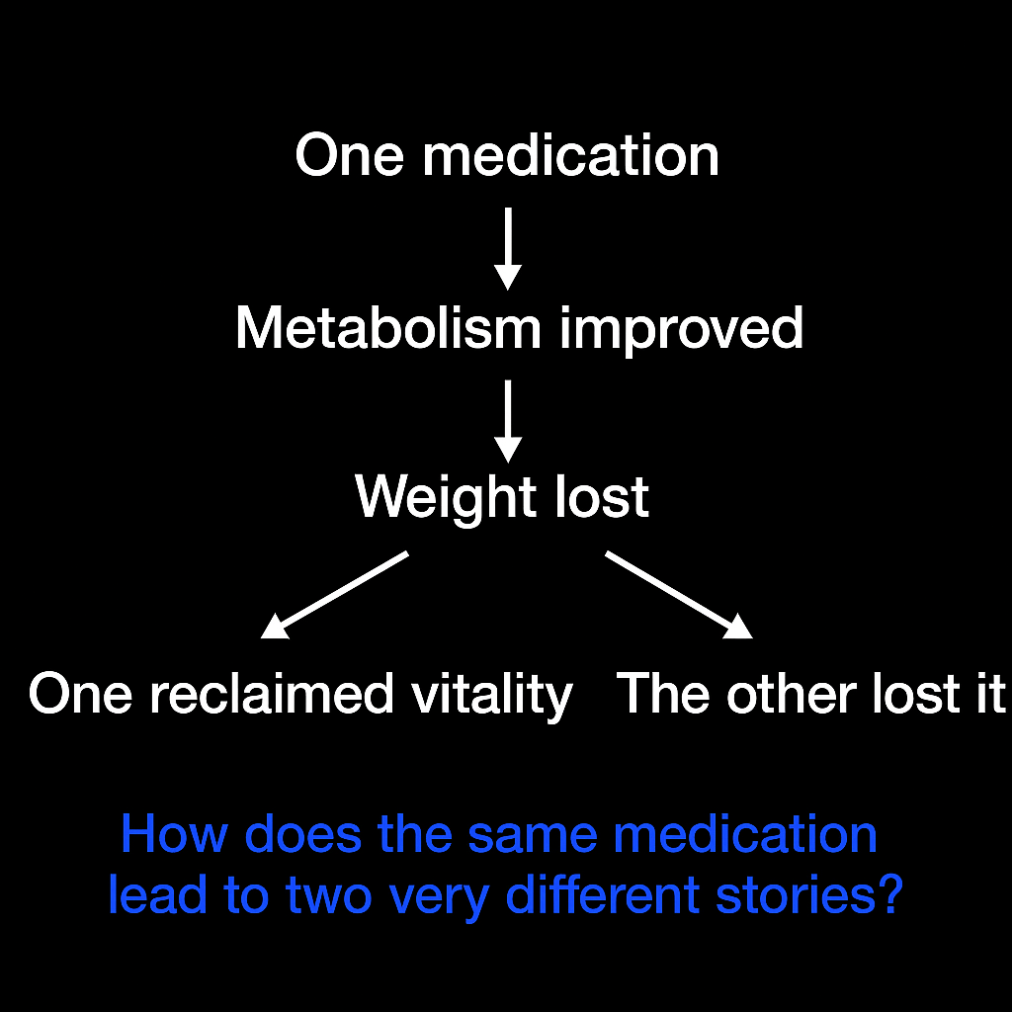
This is What We Have!

Slide 8
Unpacking The Paradox

Slide 9

How many of you routinely check an A1c or lipid panel for your patients?

Slide 10
The Overlooked Crisis:
Cardiometabolic Mortality in Severe Mental Illness
Patients with severe mental illness die 10-20 years earlier than the general population.
Cardiovascular diseases are the leading cause of death among people with SMI
Cardiovascular mortality rate for people with SMI >2X the general population
Variety of factors:
    High prevalence modifiable cardiovascular behaviors and conditions
    Disparities in access and quality of care
    Medication
    Direct pathophysiologic changes
Notes:
Before we get to GLP-1s, let’s remember why this matters.
Patients with severe mental illness die 10–20 years earlier than the general population—mostly from cardiovascular disease, not suicide.
Cardiovascular mortality risk is more than twice that of the general population and rising.
The causes are multifactorial: lifestyle factors, disparities in care, medication effects, and direct pathophysiologic changes like chronic inflammation and HPA-axis activation.
It reminds us that psychiatric care must include cardiometabolic care.

Slide 11
Physiology of Brain & Gut

Slide 12
Pathophysiology of Eating
Weight
Gut & Adipose tissue hormones
Brain 🧠
Hunger, perception, cognition, emotion and behavior
impacts
Notes:
Energy balance is controlled by the brain through signals from adipose and gut hormones—leptin, adiponectin, ghrelin, and GLP-1.
These signals converge in the hypothalamus, limbic system, and cortex to influence hunger, reward, and emotion.
When these loops malfunction—through inflammation, insulin resistance, or medication effects—we see changes not only in weight but also in drive, anhedonia, and impulsivity.

Slide 13
Energy balance is regulated by the brain with complex inputs from:
Adipose tissue hormones
Leptin:
Secreted by white adipose tissue.
Core hormone to control body weight.
Levels proportional to body mass fat = (implies) weight loss = less appetite and decreased energy expenditure.
Adiponectin
Synthesized by white adipose tissue.
Levels inversely proportional to body fat mass (higher body fat → lower adiponectin)
Cytokines
(IL-6, TNF)
Notes:
Leptin, secreted from fat tissue, tells the brain we’re full—but in obesity, the brain becomes leptin-resistant.
Adiponectin works inversely—lower levels mean worse insulin sensitivity.
Cytokines like IL-6 and TNF add inflammatory tone, linking obesity and mood disorders

Slide 14
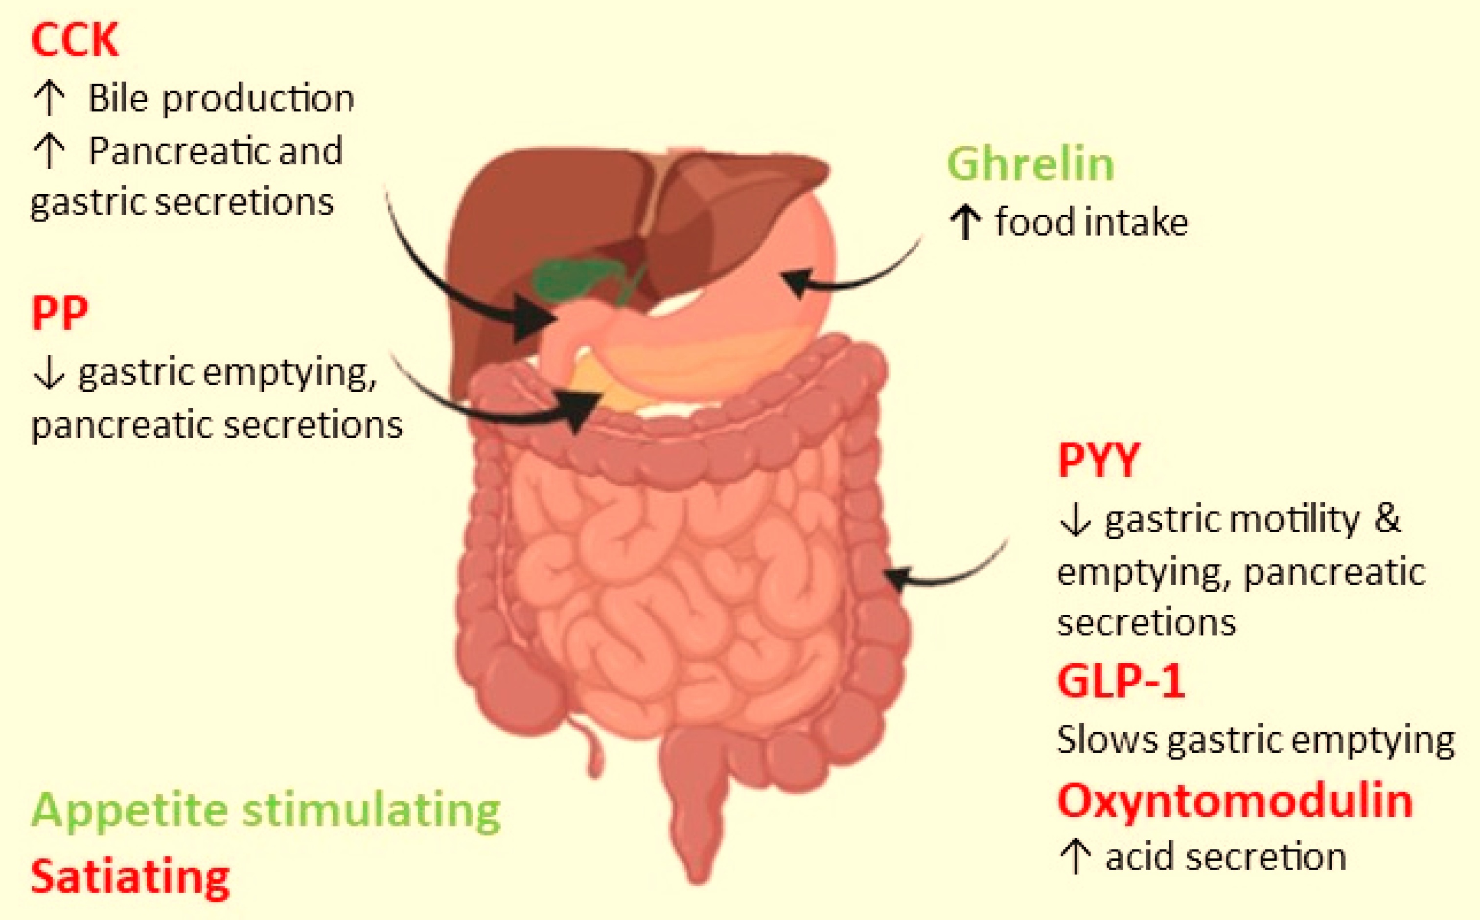
Energy balance is regulated by the brain with complex inputs from:
2. Gut hormones
Notes:
Gut hormones such as GLP-1, PYY, and ghrelin communicate satiety and energy status to the brain.
Disruptions in these signals contribute to overeating, low motivation, and metabolic dysregulation—core features overlapping with psychiatric illness.

Slide 15
Glucagon-Like Peptide-1 (GLP-1)
Gut‑derived incretin hormone produced by L-cells of the distal bowel and colon
Secreted in response to nutrient intake: carbohydrate, protein, and fat ingestion
Half‐lives for intact GLP‐1 have been determined ~2min.
Effects:
    Glucose dependent insulin secretion → diabetes control
    Reduced hepatic gluconeogenesis (suppresses glucagon)
    Delayed gastric emptying → diabetes control and increased satiety
    Reduced appetite → weight loss
Notes:
“GLP-1 is an incretin hormone released by intestinal L-cells after eating.
It enhances insulin secretion, suppresses glucagon, slows gastric emptying, and reduces appetite—leading to weight loss and glucose control.”
Semaglutide, Liradlutide, Exenatide,

Slide 16
Glucagon-Like Peptide-1 (GLP-1)
Degraded by dipeptidyl peptidase-4 (DPP-IV) enzyme peripherally.
Reduced in
  Obesity
  Pre-diabetes
  Type 2 diabetes
Notes:
Native GLP-1 is rapidly degraded by DPP-IV, so synthetic analogs like liraglutide and semaglutide were developed.
They’re FDA-approved for diabetes and chronic weight management.
Reduced endogenous GLP-1 is seen in obesity and pre-diabetes—conditions we see daily in psychiatry.
Briefly talk about GIP

Slide 17
Glucose‐dependent Insulinotropic Polypeptide (GIP)
GIP is secreted from K cells of the upper intestine
Half‐lives for intact GIP as approximately 5 min.
Rapidly undergoes proteolytic processing by dipeptidyl peptidase‐4 (DPP‐4
Inactivated and excreted from the kidney.
Notes:
Tirazeptide

Slide 18
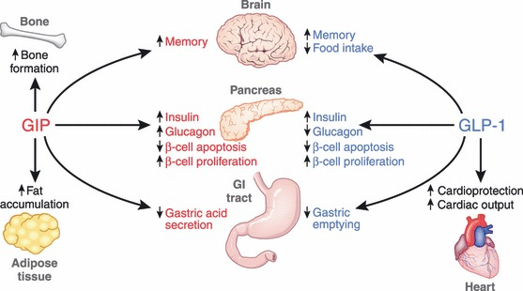
Pancreatic and exo-pancreatic function of glucose‐dependent insulinotropic polypeptide (GIP) and glucagon‐like peptide (GLP)‐1. GIP acts directly on the endocrine pancreas, bone, fat, gastrointestinal (GI) tract and brain. GLP‐1 acts directly on the endocrine pancreas, gastrointestinal tract, heart and brain.

Slide 19

GLP-1 Receptor Agonist in Psychiatric Disorder

Slide 20

If you had to guess
Can GLP-1 cross the blood–brain barrier?
Notes:
yes — it acts on hippocampus, amygdala, hypothalamus.) though some central effects are also mediated indirectly via vagal and peripheral signaling

Slide 21
GLP-1 Neurobiological Mechanisms
Neurogenesis and Synaptic Plasticity
GLP-1 receptor activation → hippocampal neurogenesis and supports synaptic plasticity, enhancing neural connectivity involved in mood and cognition.
Neurotransmitter Modulation
GLP-1 receptors in mood-regulating brain regions (prefrontal cortex, amygdala, hypothalamus) modulate serotonin, dopamine, and glutamate, influencing affect and stress response.
Neuroinflammation and Oxidative Stress
GLP-1 RAs reduce neuroinflammation and oxidative stress, potentially protecting against neurodegenerative and mood-related pathology.
Notes:
GLP-1 receptor activation supports neurogenesis and synaptic plasticity—especially in the hippocampus.
It modulates neurotransmitters like serotonin and dopamine in the prefrontal cortex, amygdala, and hypothalamus.
It also dampens neuroinflammation and oxidative stress.
Together, these effects suggest that GLP-1RAs might influence mood, cognition, and stress regulation.”

Slide 22
GLP-1s in Psychiatric Disorders
Developed for diabetes and obesity
Noticed mood improvements patients with diabetes
Investigations into GLP-1RAs managing psychiatric conditions.
Emerging therapeutic promise
Notes:
GLP-1 most influences: dopamine, serotonin, or glutamate?”
(Answer: All three, but especially dopamine and glutamate pathways — reinforces integrative neurobiology.)

Slide 23
GLP-1s in Psychiatric Disorders
Preclinical studies (preliminary evidence) in animal models have demonstrated that GLP-1 receptor activation:
Promotes neurogenesis and enhances synaptic plasticity
Modulates stress response pathways in mood disorders
Reduces neuroinflammation and oxidative stress
Notes:
Animal models show that GLP-1 activation promotes neurogenesis, regulates stress-response pathways, and reduces inflammation.
These effects parallel what antidepressants and mood stabilizers attempt to achieve through different mechanisms.”

Slide 24
GLP-1s in Psychiatric Disorders
Clinical data (human studies)
Mechanisms hypothetical and under investigation
Suggest improvement in depressive symptoms
Emerging signals in bipolar disorder and schizophrenia.
Notes:
Human data remain limited, but early studies show potential improvements in depressive symptoms and metabolic health in patients with bipolar disorder and schizophrenia.
The mechanisms are still under investigation.

Slide 25
GLP-1s in Psychiatric Disorders
Neurodegenerative application: GLP-1RA exhibit neuroprotective effects by crossing blood brain barrier:
Improve Cognition & Motor Function
Reduce β-amyloid plaques
Reduce oxidative stress
Reduce inflammation
Notes:
Because GLP-1RAs cross the blood–brain barrier, they’ve been studied in Alzheimer’s and Parkinson’s disease.
Findings include improved cognition, reduced β-amyloid plaques, and less oxidative stress.
Semaglutide is now in Phase 3 Alzheimer’s trials, and exenatide in Parkinson’s—evidence that the neuroprotective promise is real

Slide 26
GLP-1s in Psychiatric Disorders
Clinical Evidence
Semaglutide shows strong preclinical promise.
Ongoing: Phase 3 trials in AD and (pending) Phase 2 trial in PD (USA).
Clinical results so far are mixed, trials involving liraglutide and exenatide, but encouraging
Neurodegenerative application:

Slide 27


GLP-1s in Psychiatric Disorders
Antipsychotic induced metabolic complication
GLP-1 RAs (e.g., exenatide, liraglutide) reduce weight gain and metabolic risks in patients on antipsychotics such as clozapine and olanzapine.
TAO trial: modest 2.3 kg weight loss over 3 months and improved lipid/glucose markers.
Notes:
Several small trials show GLP-1RAs can mitigate antipsychotic-induced weight gain and metabolic abnormalities—especially with clozapine and olanzapine.
The TAO trial reported a modest but meaningful 2.3 kg weight loss and improved lipids and glucose over three months.
This may allow psychiatrists to continue effective antipsychotics without worsening metabolic burden

Slide 28

GLP-1 Receptor Agonist & Addiction

Slide 29
Neurobiological Rationale
GLP-1 Receptor Agonists (e.g., semaglutide, liraglutide)
Act on Meso-corticolimbic Dopamine System
(VTA → Nucleus Accumbens → Prefrontal Cortex)
Modulate Neurotransmission
↓Excess dopamine release & ↑Glutaminergic/ GABAergic balance
“Recalibration” of Reward Circuit
Preserve normal motivation & ↓ drug/ cue-induced overactivation
↓ Craving & Relapse Risk Without Emotional Blunting
Notes:
GLP-1s act on the mesocorticolimbic dopamine pathway—ventral tegmental area to nucleus accumbens to prefrontal cortex.
They reduce excess dopamine release, normalize glutamate/GABA balance, and dampen cue-induced overactivation—without emotional blunting.
In short, they recalibrate reward sensitivity, which could help with craving-driven disorders

Slide 30
GLP-1s & Alcohol Use Disorder
Effect direction: Consistent with rodent work, human trials suggest GLP-1RAs dampen alcohol cue reactivity and may reduce consumption. Semaglutide shows early reduction in drinking and craving, while exenatide shows mixed results (no overall effect, but benefit in obese subgroup).
Evidence: Emerging clinical signal — two Phase II RCTs, one completed trial with mixed outcomes, and mechanistic neuroimaging support. Phase III data not yet available.
Clinical use (off-label): Potentially useful in AUD with obesity or metabolic disease; not yet standard of care.
Notes:
Rodent and early human studies show reduced alcohol craving and cue reactivity with semaglutide.
Exenatide results are mixed but suggest benefit in obese subgroups.
Evidence grade: emerging—two Phase II RCTs, no Phase III yet.
Off-label use might be reasonable for patients with both AUD and metabolic disease.

Slide 31
GLP-1s & Opioid Use Disorder
Opioid Use Disorder
Effect direction: Strong preclinical evidence and pilot signals that GLP-1RAs reduce opioid craving, cue reactivity, and possibly overdose risk.
Evidence grade: Very early human evidence — pilot trials and real-world pharmacoepidemiology suggest possible benefit, but confirmatory RCTs are pending.
Clinical use (off-label): Not ready for frontline use; may hold promise as an adjunct to MOUD (buprenorphine, methadone).
Key gaps: Ongoing RCTs must establish safety, tolerability, and efficacy in treatment-seeking patients, as well as impact on relapse and retention.
Effect direction: Strong preclinical evidence and pilot signals that GLP-1RAs reduce opioid craving, cue reactivity, and possibly overdose risk.
Evidence grade: Very early human evidence — pilot trials and real-world pharmacoepidemiology suggest possible benefit, but confirmatory RCTs are pending.
Clinical use (off-label): Not ready for frontline use; may hold promise as an adjunct to MOUD (buprenorphine, methadone).
Notes:
Preclinical studies are robust—GLP-1RAs reduce opioid craving and relapse in animal models.
Human evidence is still preliminary but promising.
Some pharmacoepidemiologic data hint at lower overdose risk, but we need controlled trials.
Not yet ready for frontline use, but potentially valuable as an adjunct to MOUD.

Slide 32
GLP-1s & Stimulant Use Disorder
Effect direction: Animal models consistently show GLP-1RAs reduce stimulant intake and relapse; first human lab study found no effect on acute cocaine self-administration or euphoria.
Evidence grade: Preclinical-heavy, human-light — mostly rodent work, one small crossover trial, ongoing human RCTs.
Clinical use (off-label): Not currently supported for stimulant use disorder.
Notes:
Animal data consistently show reduced stimulant intake and relapse with GLP-1s, but the first human lab study found no effect on acute cocaine use.
This remains preclinical-heavy, with ongoing RCTs.

Slide 33
GLP-1s & Tobacco Use Disorder
Tobacco Use Disorder
Effect direction: Pilot data show higher quit rates and less craving/withdrawal when GLP-1RAs are added to NRT/counseling; dulaglutide mitigates weight gain and improves metabolic outcomes but without abstinence benefit.
Evidence grade: Moderate early evidence — one promising pilot RCT, a null Phase II, and ongoing trials.
Clinical use (off-label): May be considered in overweight/prediabetic smokers where weight control is a priority; not yet supported as a first-line cessation aid.
Effect direction: Pilot data show higher quit rates and less craving/withdrawal when GLP-1RAs are added to NRT/counseling; dulaglutide mitigates weight gain and improves metabolic outcomes but without abstinence benefit.
Evidence grade: Moderate early evidence — one promising pilot RCT, a null Phase II, and ongoing trials.
Clinical use (off-label): May be considered in overweight/prediabetic smokers where weight control is a priority; not yet supported as a first-line cessation aid.
Notes:
Pilot studies suggest higher quit rates and reduced craving when GLP-1s are added to nicotine replacement and counseling.
Dulaglutide may limit post-cessation weight gain, but not necessarily improve abstinence.
Evidence is moderate—encouraging but not yet guideline-level.

Slide 34
GLP-1s & Food Addiction
Effect direction: GLP-1RAs consistently show ↓ binge severity, cravings, overeating tendencies, cue-reactivity, and weight.
Evidence grade: Emerging — pilot RCTs + mechanistic + case/observational; no large phase III BED-specific RCTs.
Clinical use (off-label): Consider in BED with obesity/metabolic disease after standard therapies, with ED-informed monitoring.
Notes:
This is the strongest behavioral overlap.
GLP-1RAs consistently reduce binge frequency, food cue reactivity, and weight.
Evidence is still early but mechanistically consistent.
Consider in patients with obesity or BED where standard therapy hasn’t sufficed—always with eating-disorder-informed monitoring

Slide 35

GLP-1s – Safety & Tolerability

Slide 36



GLP-1 Side Effects
Nausea, vomiting, heart burn, diarrhea, constipation, and stomach pain associated with bloating from gas*.
Fatigue, dizziness, depression, hypoglycemia, and gall bladder disease have also been reported, and the risk of developing pancreatitis is increased.
Prescribing GLP-1 receptor agonists warrants telling patients that medullary thyroid tumor risk is increased based on results of rodent studies.
Notes:
Common side effects include nausea, vomiting, constipation, and bloating—usually dose-related and transient.
Less frequent risks: fatigue, gallbladder disease, and rarely pancreatitis.
Animal data link GLP-1RAs to medullary thyroid tumors, though human relevance is uncertain.

Slide 37
GLP-1 Nutritional Concerns
Adequate hydration: (64 oz/ day)
Adequate protein intake: 1.0-1.2 g/kg protein/ day using adjusted body weight, + 25% of remaining weight.
Regular exercise: resistance exercise 20 min 2x weekly & CV exercise at least 150 minutes /week.
Balanced diet including variety of food: half of intake should be vegetables and fruit
Screening for mineral and vitamin deficiencies: possible risk of anemia, B12, Vitamin D.
Notes:
We must educate patients on hydration and adequate protein intake to avoid muscle loss.
Recommend ~1 g/kg protein daily, balanced diet, resistance and aerobic exercise, and routine vitamin B12 and D screening.
Encourage pure water intake (at least 64 ounces per day). Patients often reduce both food and water intake when using these medications, and thus dehydration may result. Acute kidney injury from dehydration has been reported. Good water intake also helps prevent constipation. Monitoring kidney function is also recommended. Regular kidney monitoring.
Adequate protein intake: 1.0-1.2 g/kg protein/ day using adjusted body weight, + 25% of remaining weight.

Slide 38
GLP-1 & Other Medications
10% to 20% of body weight → decrease patients’ prescription drug dosage.
Weight → blood pressure & diabetes improve → possible risk of
postural hypotension and hypoglycemia.
Weight → Psychotropic, Adderall®, may cause over-stimulation → dose reduction; and thyroid hormone requirements may need to be re-assessed due to possible change in absorption.
Notes:
“Because weight loss and improved metabolism alter pharmacokinetics, patients may need lower doses of antihypertensives, insulin, or psychotropics.
Monitor for postural hypotension, hypoglycemia, and potential overstimulation with agents like Adderall.
Thyroid hormone absorption can also change as body composition shifts.
GLP-1 receptor agonists can help patients lose 10% to 20% of body weight, and this may decrease patients’ other prescription drug dosage requirements.
It is not uncommon to find that blood pressure and diabetes parameters improve with weight loss, which can increase the risk for postural hypotension (BP and PTSD – Rx: Clonidine) and hypoglycemia.
Psychiatry medications, such as Adderall®, may cause over-stimulation if the dose is not reduced after weight loss, and thyroid hormone requirements may need to be re-assessed due to possible change in absorption.

Slide 39
Special Considerations for Geriatric Population
More prone to developing drug side effects.
Greater risk for developing more severe effects, including dehydration and malnutrition.
Individual assessment to balance medication benefits and risks.
Notes:
Older adults are more prone to dehydration and malnutrition on GLP-1s.
Start lower, titrate slower, and balance benefit with frailty risk.

Slide 40
The Other Side of GLP-1s:
Psychiatric and Ethical Watchpoints

Slide 41
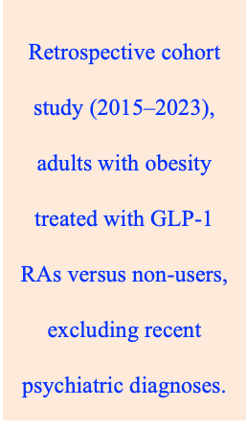
GLP-1s and Psychiatric Risk
Elevated psychiatric risk: GLP-1 RA use was associated with higher incidence of depression, anxiety, and suicidal ideation/attempts.
Demographic variation:
Females → higher anxiety (2.19×) and suicidality (2.53×) vs. males.
Younger adults (18–49) → highest suicidal risk (3.01×).
Black patients → higher suicidality (3.45×) vs. White/Asian groups.
Dose and duration effect: Risk increased with higher doses (e.g., Wegovy 2.4 mg) and longer exposure.
Temporal trend: Psychiatric risks appeared to escalate after 1 year of GLP-1 RA therapy.
Notes:
Recent real-world studies report higher rates of depression, anxiety, and suicidality with GLP-1 use—especially in younger adults, females, and Black patients.
Risks appear dose- and duration-related, peaking after one year of therapy.
We need careful psychiatric monitoring—not avoidance, but informed vigilance
The risk of depression, anxiety, and suicidal behavior in patients with obesity on glucagon like peptide-1 receptor agonist therapy
: Retrospective cohort study (2015–2023) using the U.S. TriNetX database across 66 healthcare systems, comparing adults with obesity treated with GLP-1 RAs (liraglutide, semaglutide) versus non-users, excluding those with recent psychiatric diagnoses. within 1 year before or 1 month after GLP-1 initiation.

Slide 42
Clinical & Ethical Relevance for Psychiatrists
Clinical
Psychiatric follow-up offers early detection and contextual interpretation of emerging mood changes
Ethical
Informed consent should include emotional and cognitive effects, not just GI side effects and weight loss.
The goal is risk-informed use, not fear-based avoidance.
Patients with psychiatric comorbidities are at higher baseline risk yet often not monitored
Notes:
“Psychiatric patients are already high-risk for metabolic and mood instability.
Psychiatrists can uniquely detect emerging emotional side effects early.
Ethically, informed consent should cover cognitive and emotional effects—not just GI or weight aspects.
The goal is risk-informed, not fear-based, prescribing.

Slide 43
GLP-1s Safety Checklist

Slide 44
Baseline & Monitoring Recommendations for GLP-1 Therapy
Baseline Evaluation
  A1c – assess glycemic status
  Lipid panel – evaluate cardiovascular risk
  Comprehensive Metabolic Panel (CMP) – check hepatic and renal function
  Optional: TSH, CBC, pregnancy test (as clinically indicated)
Follow-Up Monitoring
  Repeat A1c, lipids, CMP every 3–6 months during dose titration
  Annual monitoring once stable
  Assess weight, mood, and appetite changes at each visit
Handelsman et al., 2020; Garvey et al., 2022
Notes:
“Baseline labs: A1c, lipid panel, CMP for renal and hepatic function, and others as indicated.
Recheck every 3–6 months during titration, then annually once stable.
At each psychiatric visit, assess mood, appetite, and weight trends.

Slide 45
Clinical Cases Discussion

Slide 46
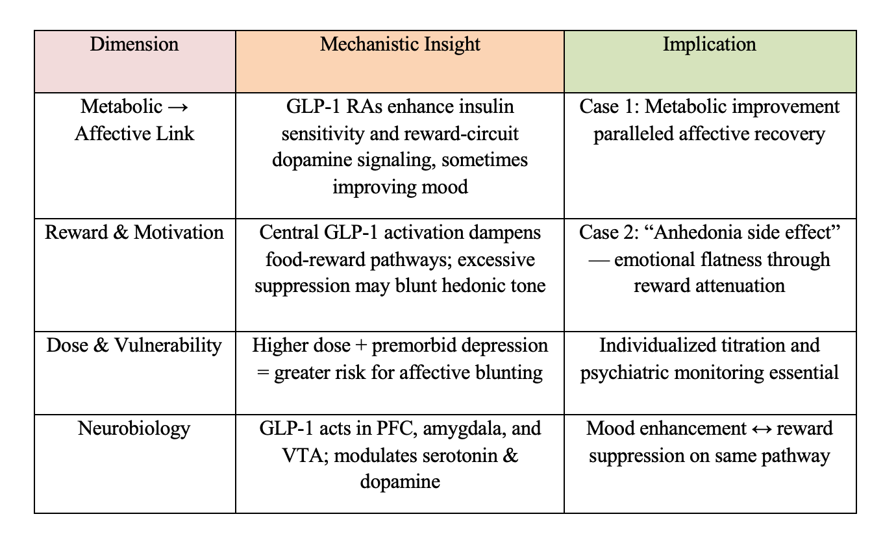
Case 1 vs Case 2
Notes:
2 patients had such different experiences — even though both were on the same molecule.
Metabolic → Affective Link
At the metabolic–affective level, GLP-1 receptor agonists enhance insulin sensitivity and can restore dopamine signaling in reward circuits.
In our first case, that translated into brighter affect and renewed motivation — her body felt lighter, and so did her mind.
This is that powerful mind–metabolism connection we often overlook in psychiatry.
Reward & Motivation
But on the flip side — that same pathway also suppresses food-reward signaling.
In some individuals, especially when pushed too far, it can dampen hedonic tone.
In our second case, this meant emotional flattening and loss of pleasure — an anhedonic side effect, not classic depression, but a kind of reward under-activation.”
Dose & Vulnerability
Dose and vulnerability
The first patient was on a modest 0.5-milligram dose, while the second titrated faster to 1 milligram with a history of recurrent depression.
That combination — higher dose and pre-existing affective fragility — may heighten the risk for blunting.
It underscores the need for individualized titration and psychiatric monitoring whenever we co-manage these agents.”
Neurobiology
And neurobiologically, both outcomes trace back to the same circuits — the prefrontal cortex, amygdala, and ventral tegmental area.
GLP-1 influences serotonin and dopamine tone in these regions.
So, whether the result is mood enhancement or reward suppression depends not on the drug itself, but on the neural starting point of the patient.”
the same pathway that lifted one mind lightened another too much.
GLP-1 receptor agonists remind us that the gut–brain axis doesn’t just shape metabolism — it rewires motivation, emotion, and meaning.
And that’s where psychiatry must now engage.”

Slide 47
Summary

Slide 48
Key Message
GLP-1 receptor agonists bridge metabolism and mood; but their bidirectional brain effects require psychiatric oversight, personalized dosing, and integrated care.

Slide 49
Takeaway
GLP-1 receptor agonists (and dual GIP/GLP-1 agents) are redefining treatment intersections between metabolic and psychiatric medicine.
Their mechanisms extend beyond glucose regulation, influencing reward, motivation, and affective tone via central dopamine and serotonin pathways.
Evidence supports metabolic and cognitive benefits, but clinicians must remain vigilant for affective blunting or mood destabilization, especially in vulnerable populations.
Individualized titration and interdisciplinary care - psychiatry, endocrinology, and primary care- are key to maximizing benefits and minimizing risks.
In psychiatric practice, GLP-1 agents represent a biological bridge between mind and metabolism, demanding both scientific precision and empathic oversight.

Slide 50
References

Slide 51
References
Baron DA, Mishrekar A, Kazmi S. Effects of exercise on mortality rates of individuals with severe mental illness. Front Psychiatry. 2022 Oct 4;13:907624. doi: 10.3389/fpsyt.2022.907624. PMID: 36267854; PMCID: PMC9577093.
Severe Mental Illness and Cardiovascular Disease: JACC State-of-the-Art Review
Authors: Michael Goldfarb michael.j.goldfarb@mcgill.ca, Marc De Hert, Johan Detraux, Katherine Di Palo, Haroon Munir, Sanela Music, Ileana Piña, and Petter Andreas RingenAuthors Info & Affiliations Publication: JACC. Volume 80, Number 9
Alhabeeb, H., AlFaiz, A., Kutbi, E., AlShahrani, D., Alsuhail, A., AlRajhi, S., Alotaibi, N., Alotaibi, K., AlAmri, S., Alghamdi, S., & AlJohani, N. (2021). Gut Hormones in Health and Obesity: The Upcoming Role of Short Chain Fatty Acids. Nutrients, 13(2), 481. https://doi.org/10.3390/nu13020481
Adapted from Endocrine Society & AACE Guidelines (Handelsman et al., 2020; Garvey et al., 2022);

Slide 52
References
Gunturu S. The Potential Role of GLP-1 Agonists in Psychiatric Disorders: A Paradigm Shift in Mental Health Treatment. Indian J Psychol Med. 2024 May;46(3):193-195. doi: 10.1177/02537176241246744. Epub 2024 Apr 12. PMID: 38699771; PMCID: PMC11062310.
https://www.jlgh.org/Past-Issues/Volume-20-Issue-2/YanWray_glp1_safety.aspx
Amorim Moreira Alves G, Teranishi M, Teixeira de Castro Gonçalves Ortega AC, James F, Perera Molligoda Arachchige AS. Mechanisms of GLP-1 in Modulating Craving and Addiction: Neurobiological and Translational Insights. Med Sci (Basel). 2025 Aug 15;13(3):136. doi: 10.3390/medsci13030136. PMID: 40843757; PMCID: PMC12372146.
Kornelius, E., Huang, JY., Lo, SC. et al. The risk of depression, anxiety, and suicidal behavior in patients with obesity on glucagon like peptide-1 receptor agonist therapy. Sci Rep 14, 24433 (2024). https://doi.org/10.1038/s41598-024-75965-2
Notes:
Adapted from Endocrine Society & AACE Guidelines (Handelsman et al., 2020; Garvey et al., 2022);

Slide 53


Slide 54
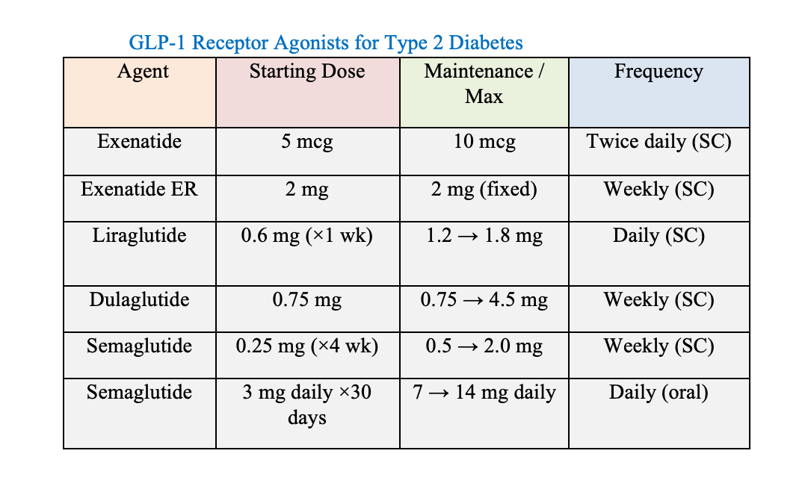
Clinical Dosing & Indications

Slide 55
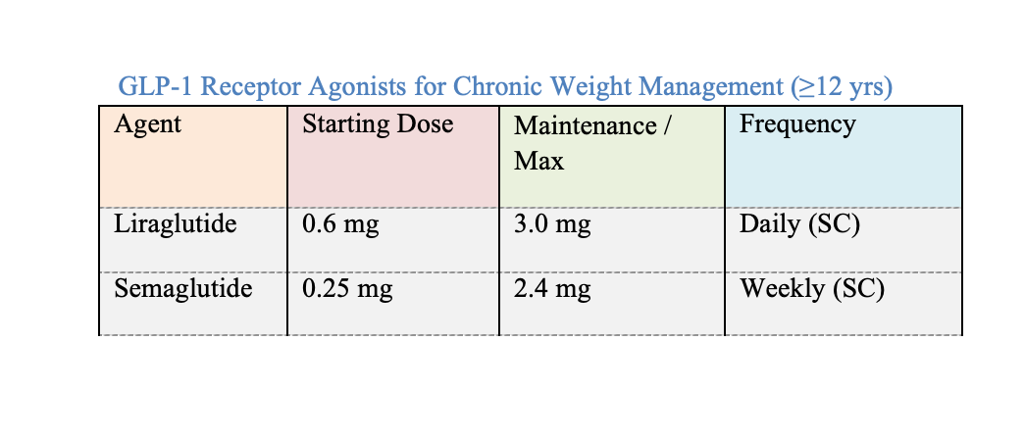
Clinical Dosing & Indications

Slide 56
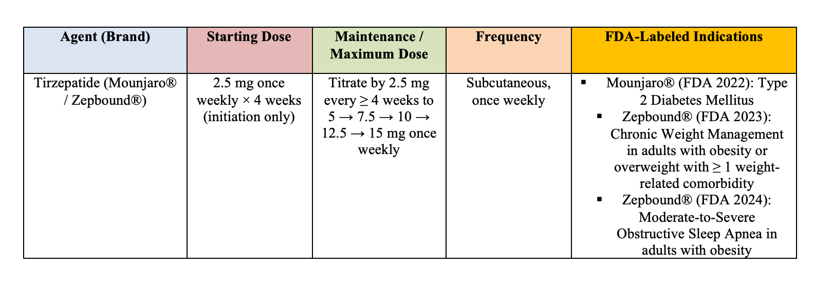
Clinical Dosing & Indications

